Slide 1

ADV100
Interactive Flat Panel Display
ADV100-Professional
whiteboard experience
Experience seamless interactivity with our high-precision touchscreens and smart palm recognition on Riotouch displays, designed for both
teaching and business presentations.

Slide 2
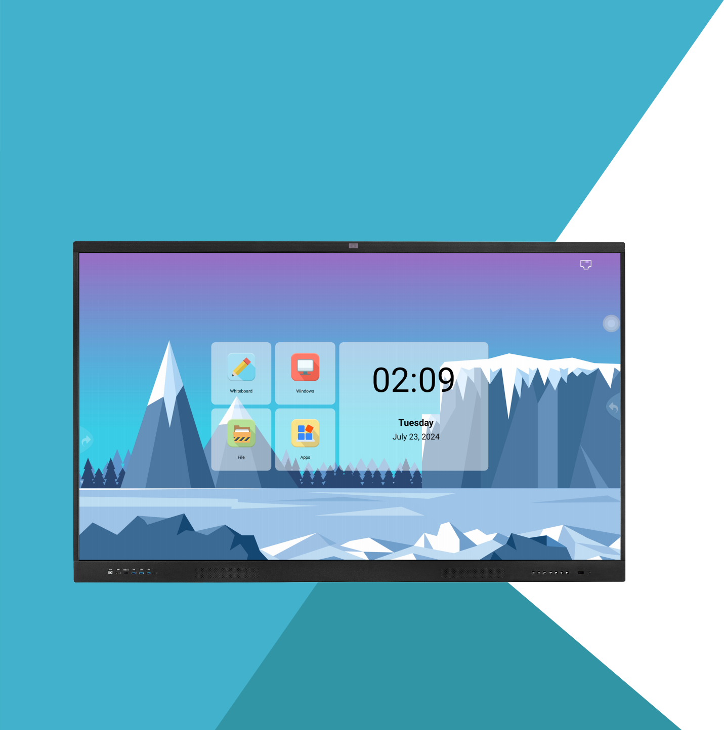
Riotouch ADV100 is an Entry level but cost-effective Interactive flat panel. The highlight advantages:
Cost-effective: Integrated 8GB RAM and 128GB ROM android 14.0 OS.
Dual pen IR touch: Automatically detects pen diameter (3mm & 8mm) and
write simultaneously with different colors and thicknesses.
All in one 4K UHD touch screen with IR multi-touch
Multi-touch: 40 points touch in windows and 20 points touch in Android
Smart Whiteboard Software: User-friendly, more efficient and creative.
Collaborative Presentations: Real-time screen sharing between devices with
wireless software
Dual OS: OPS is option for the clients who want to use Windows.

Slide 3



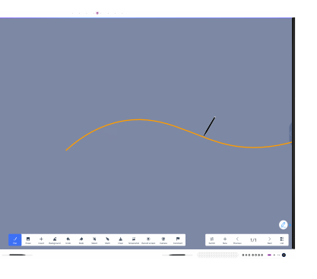


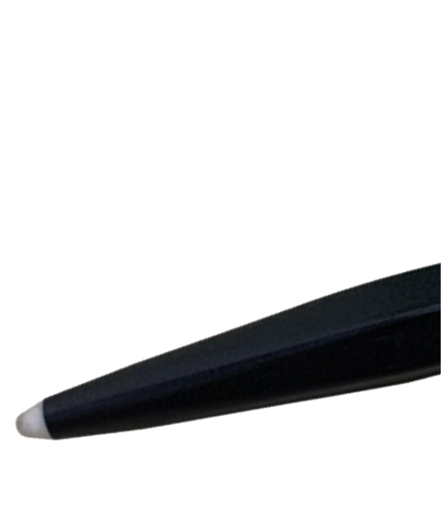
Naturally Smooth Writing with Digital Accuracy
Write, annotate, and collaborate during presentations with a pen-on-paper feel. With dual-pen recognition
to support group collaboration, and Ultra Fine Touch technology and 3mm tipped pens for lag-free digital precision, offers unparalleled writing accuracy with a natural ﬂow.
3mm
Diameter Pen
Palm Rejection
Palm recognition technology minimizes errant
touch inputs from palms, wrists, sleeves, etc., so that users can write and annotate freely.
Up to 40 points of touch

Slide 4





4K HIGH-DEFINITION DISPLAY
HEALTHY AND EYE PROTECTION
4K ultra-clear anti-glare display,data, video and other content can
be clearly restored, The presentation report is wonderful, the screen hardness is scratch-resistant and the writing touc is smooth.
Anti-glare Reduce specularity 3840*2160px
178。
backlight life >50,000 hours Viewing angle 178°

Slide 5
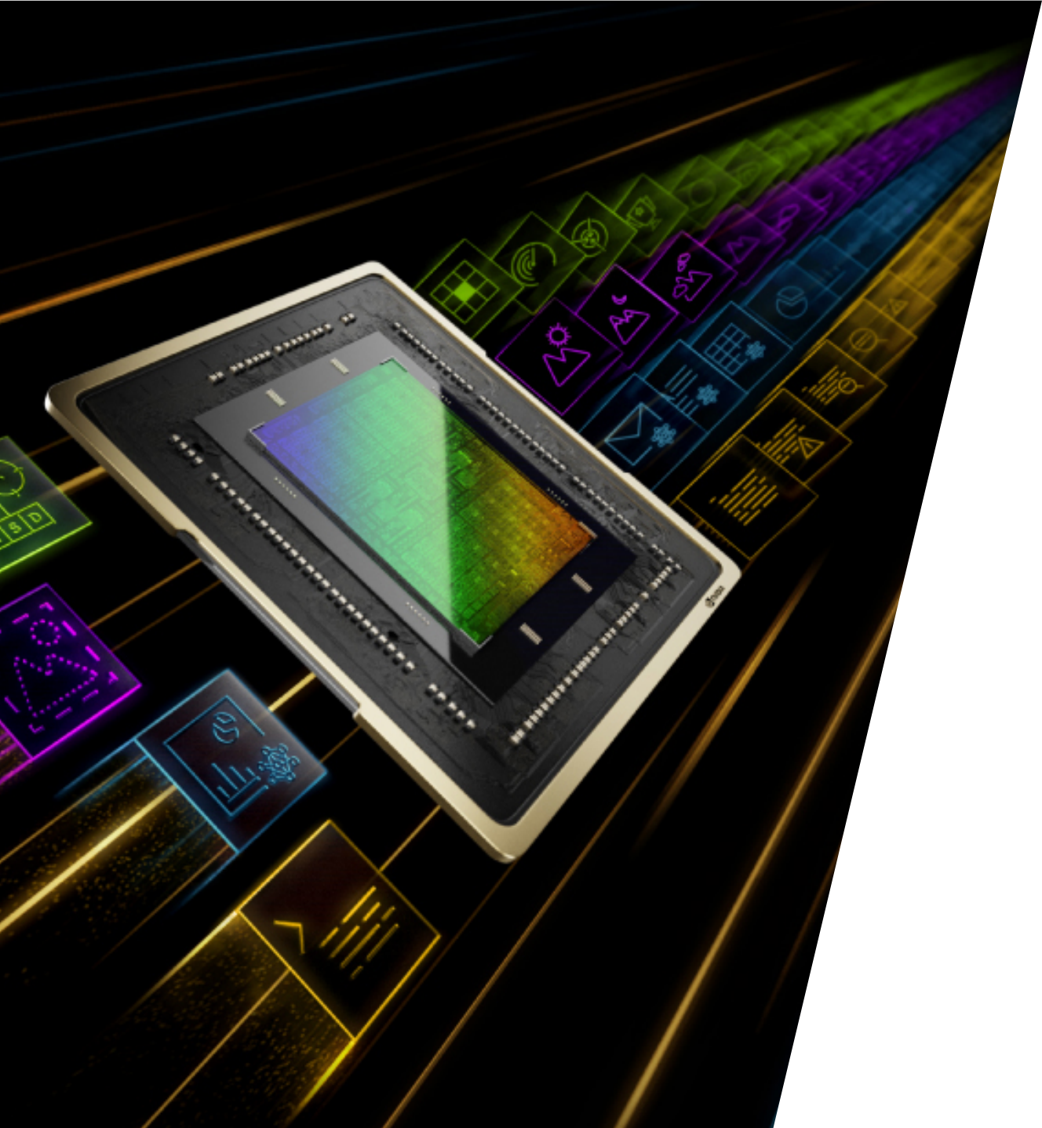
High speed WIFI6
Super fast & stable wifi 6 offers speeds up to 1501Mbps(2.4GHz
300Mbps; 5GHz 1201Mbps), providing a faster and lower latency wireless network experience.
WIFI6
2.4GHz + 5GHz 1501Mbps
WIFI 6
5GHz 433Mbps
WIFI 5

Slide 6

4800W ultra clear built-in
camera enables high-definition video conferencing
Auto focus, clear and delicate image quality, supports installation of main-
stream remote conference software at home and abroad, quickly opens
efficient remote conferences, 4K ultra clear display video conferences, real-
time synchronized information transmission, allowing remote teams to chat naturally like face-to-face.

Slide 7



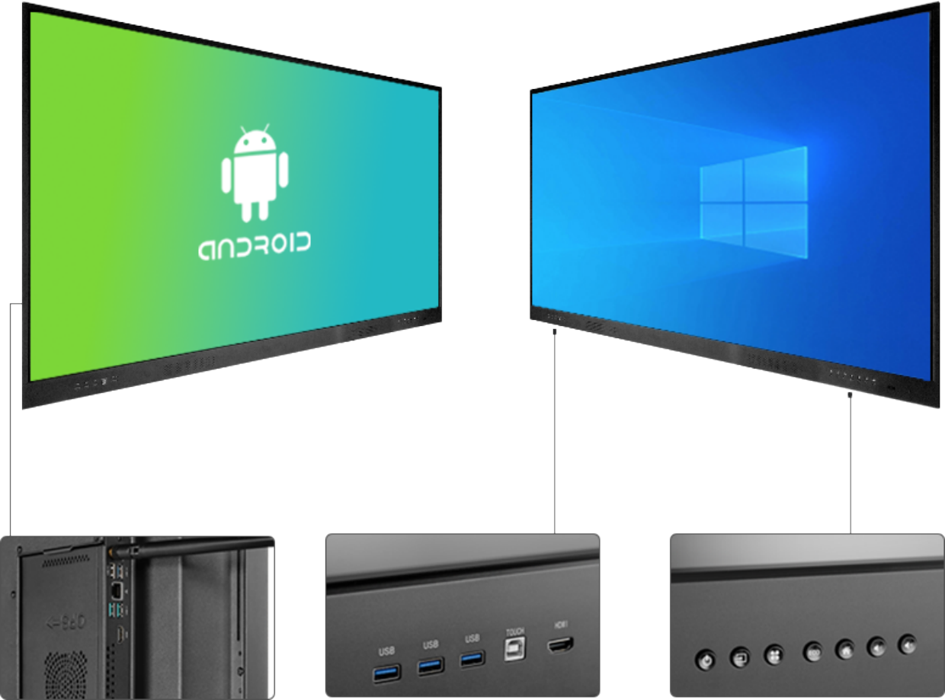


Dual OS System
Android
Windows10

Slide 8
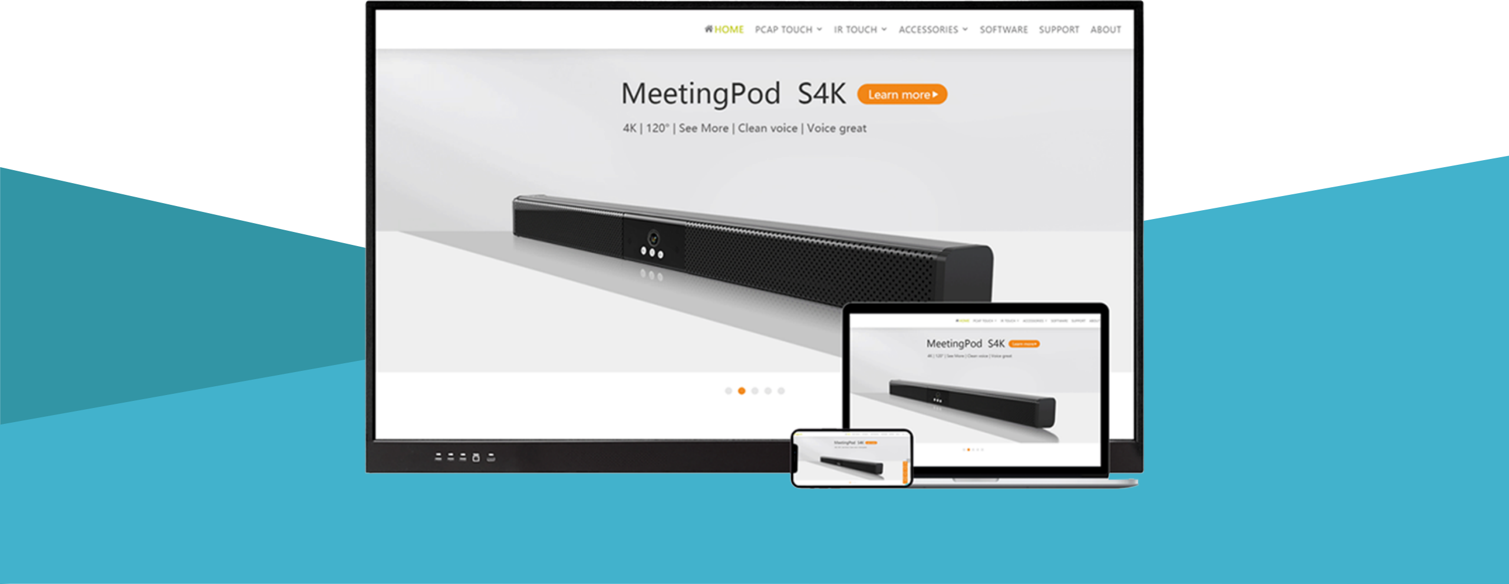
Real Time Collaboration
Simple connection with all phones, tablets and computers

Slide 9

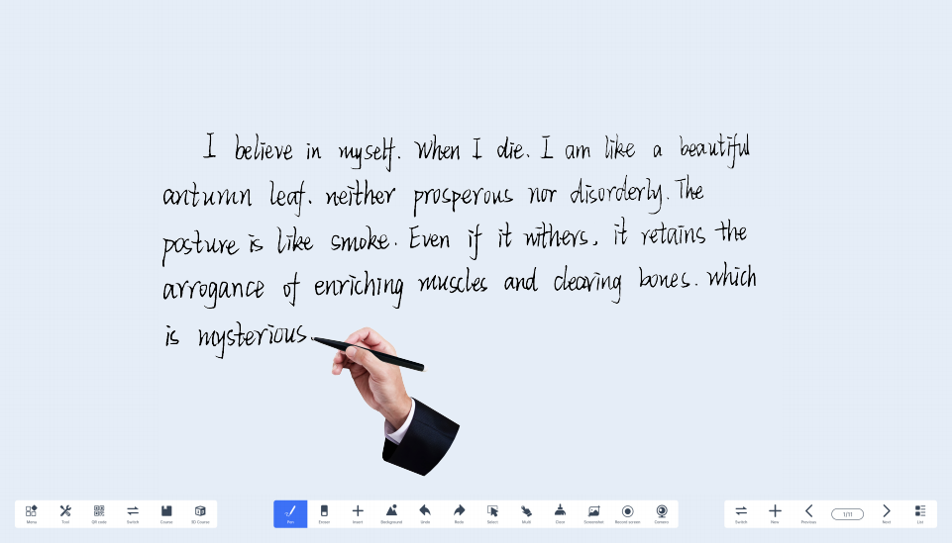
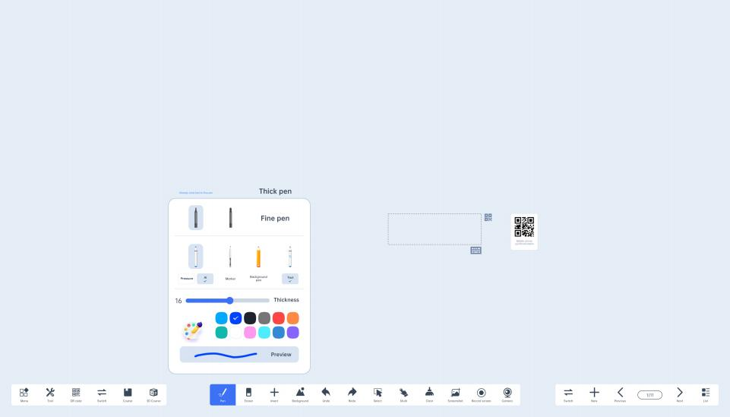
Transform Your Writing with Umind Advanced AI Pen
AI-powered pen tools, integrated into our Umind whiteboard software, offer unparalleled accuracy and intuitive functionality.
Ai ABC
I believe in myself, When I die. I am like a beautiful
antumn leaf. neither prosperous nor disorderly. The
posture is like smoke. Even if it withers, it retains the ar- rogance of enriching muscles and clearing bones.
which is mysterious.

Slide 10
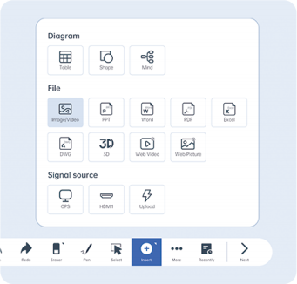

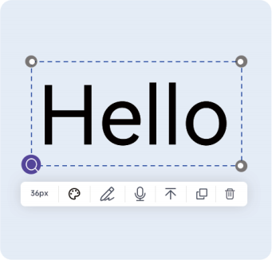
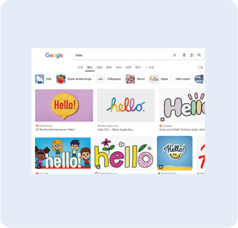

Transform lmages into Actionable Insights
From Image to Insight "Capture. Convert. Conquer." "With ADV100, capturing an image is just the beginning. Convert it into text and conquer the information it holds. Whether it's documents, receipts,or notes, ADV100's OCR turns images into insights at your fingertips."
Import pictures
Image recognition
Object handling
Google search

Slide 11

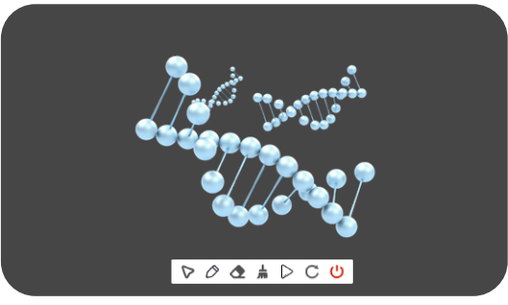
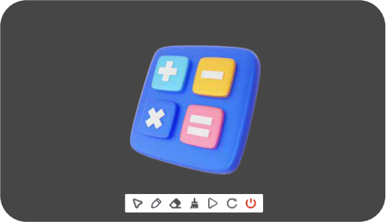


ADV100: The Core of Your 3D Vision Transform Ideas into Reality
Natural Sciences
Engineering and Technology
Engineering and Robotics
Mathematics
Arts
Art and Design
Social Sciences

Slide 12
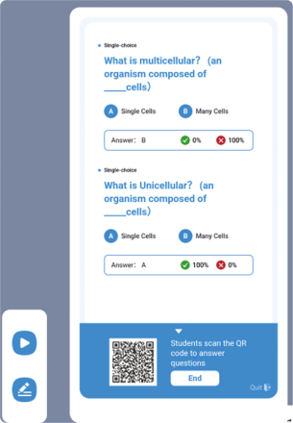
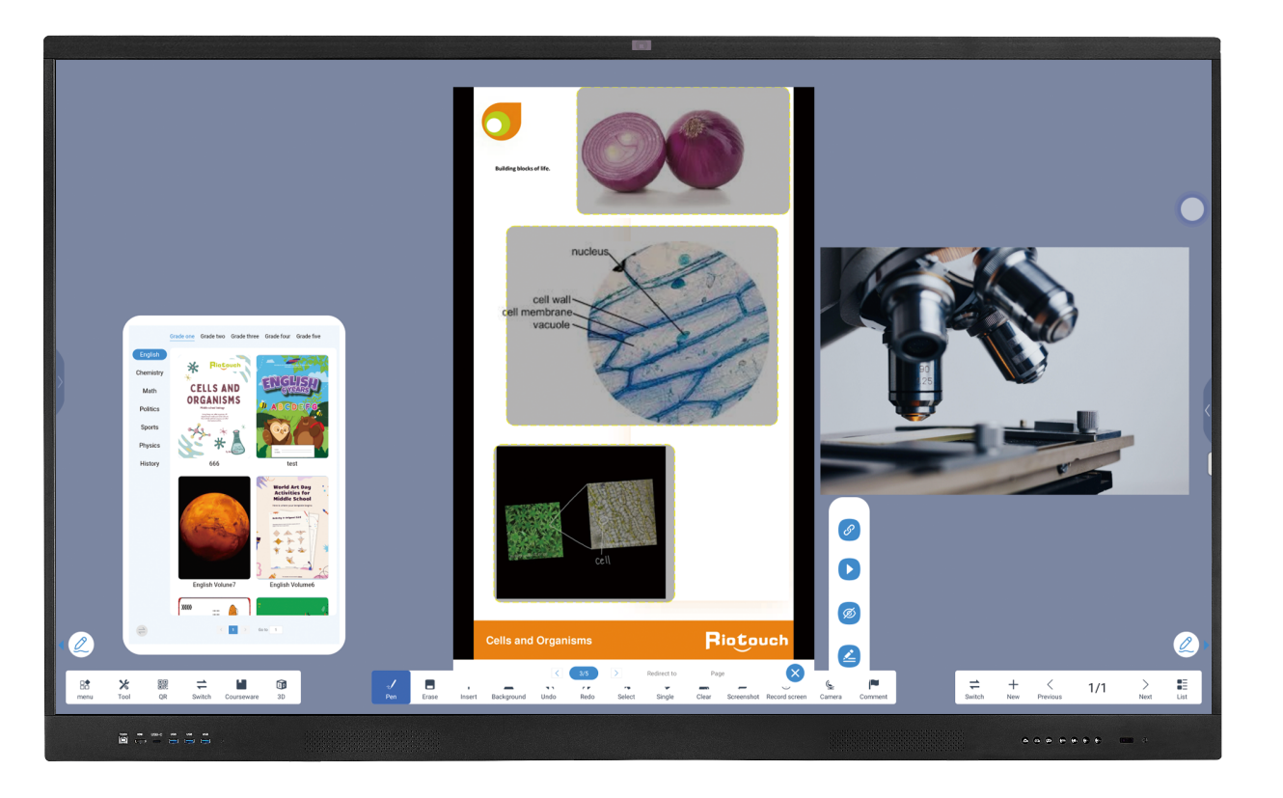

Empowering Education, Amplifying Insights
- Your gateway to a world of science and math
Quiz
From primary to higher education, our platform,covers a
wide range of subjects, igniting curiosity and fostering d-
eep understanding. Customize your curriculum, create
dynamic content, and contribute to a learning revolution
that transforms teaching and empowers learners to ach- ieve more."
Courseware Function-Ucourse

Slide 13

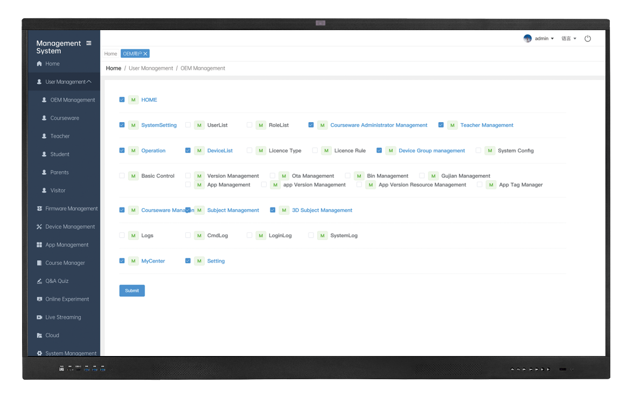
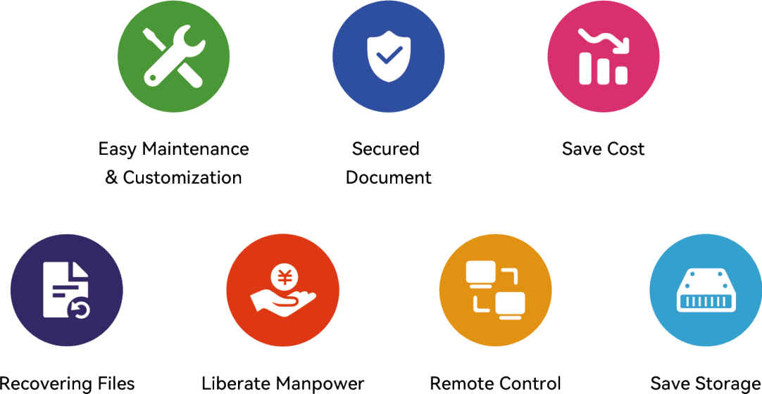
DMS-"Simplify, Streamline, Secure."
Secure your documents, smarten your management, and enjoy a seamless experience, all in one unified platform."

Slide 14
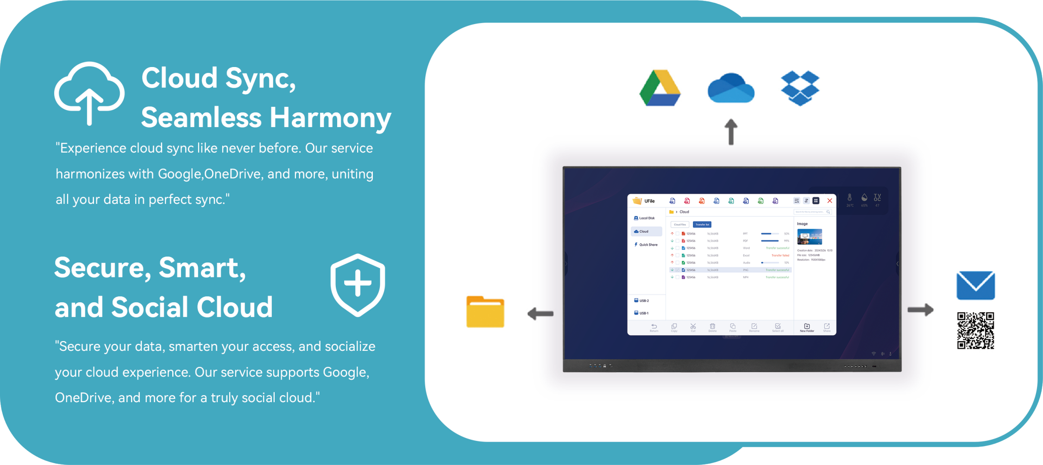

Slide 15
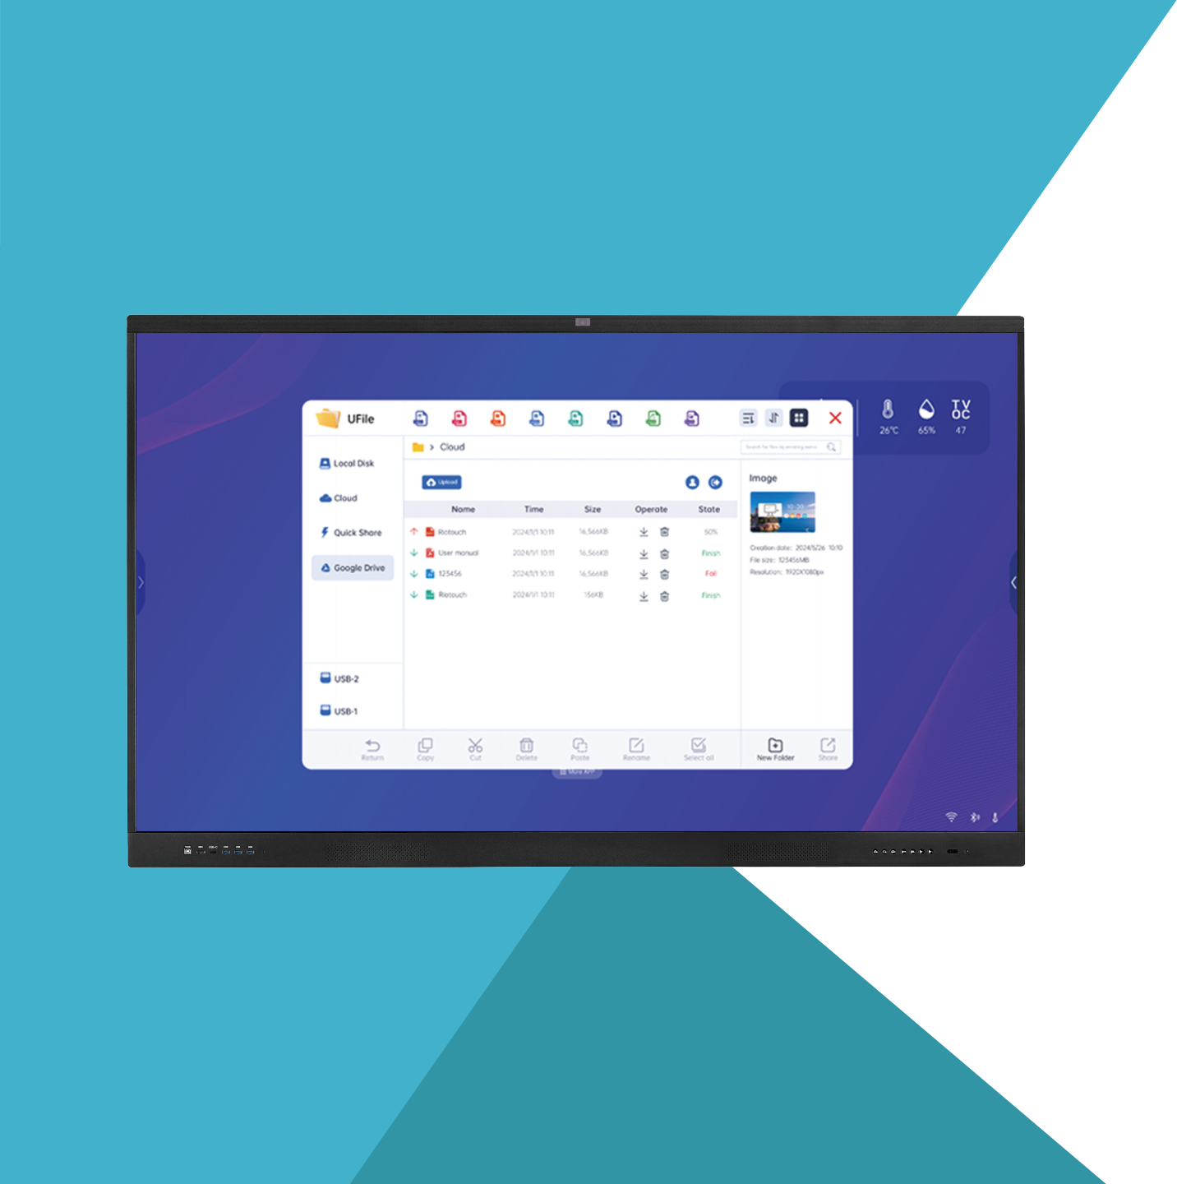
Beyond the Drive, Into the Cloud
- Step beyond the drive and into the cloud with our service.
- Multi-user functionality meets Google, OneDrive, and other
cloud giants.

Slide 16

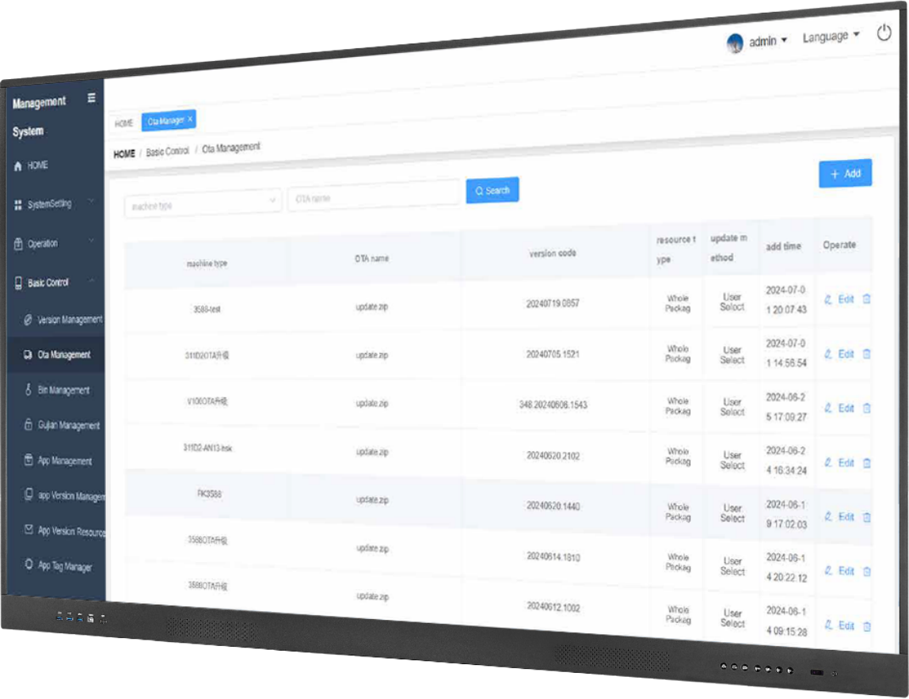
The Power of Now,In Every Update
Feel the power of now with everyOTA update.
Immediate,impactful,and alwaysimproving.

Slide 17
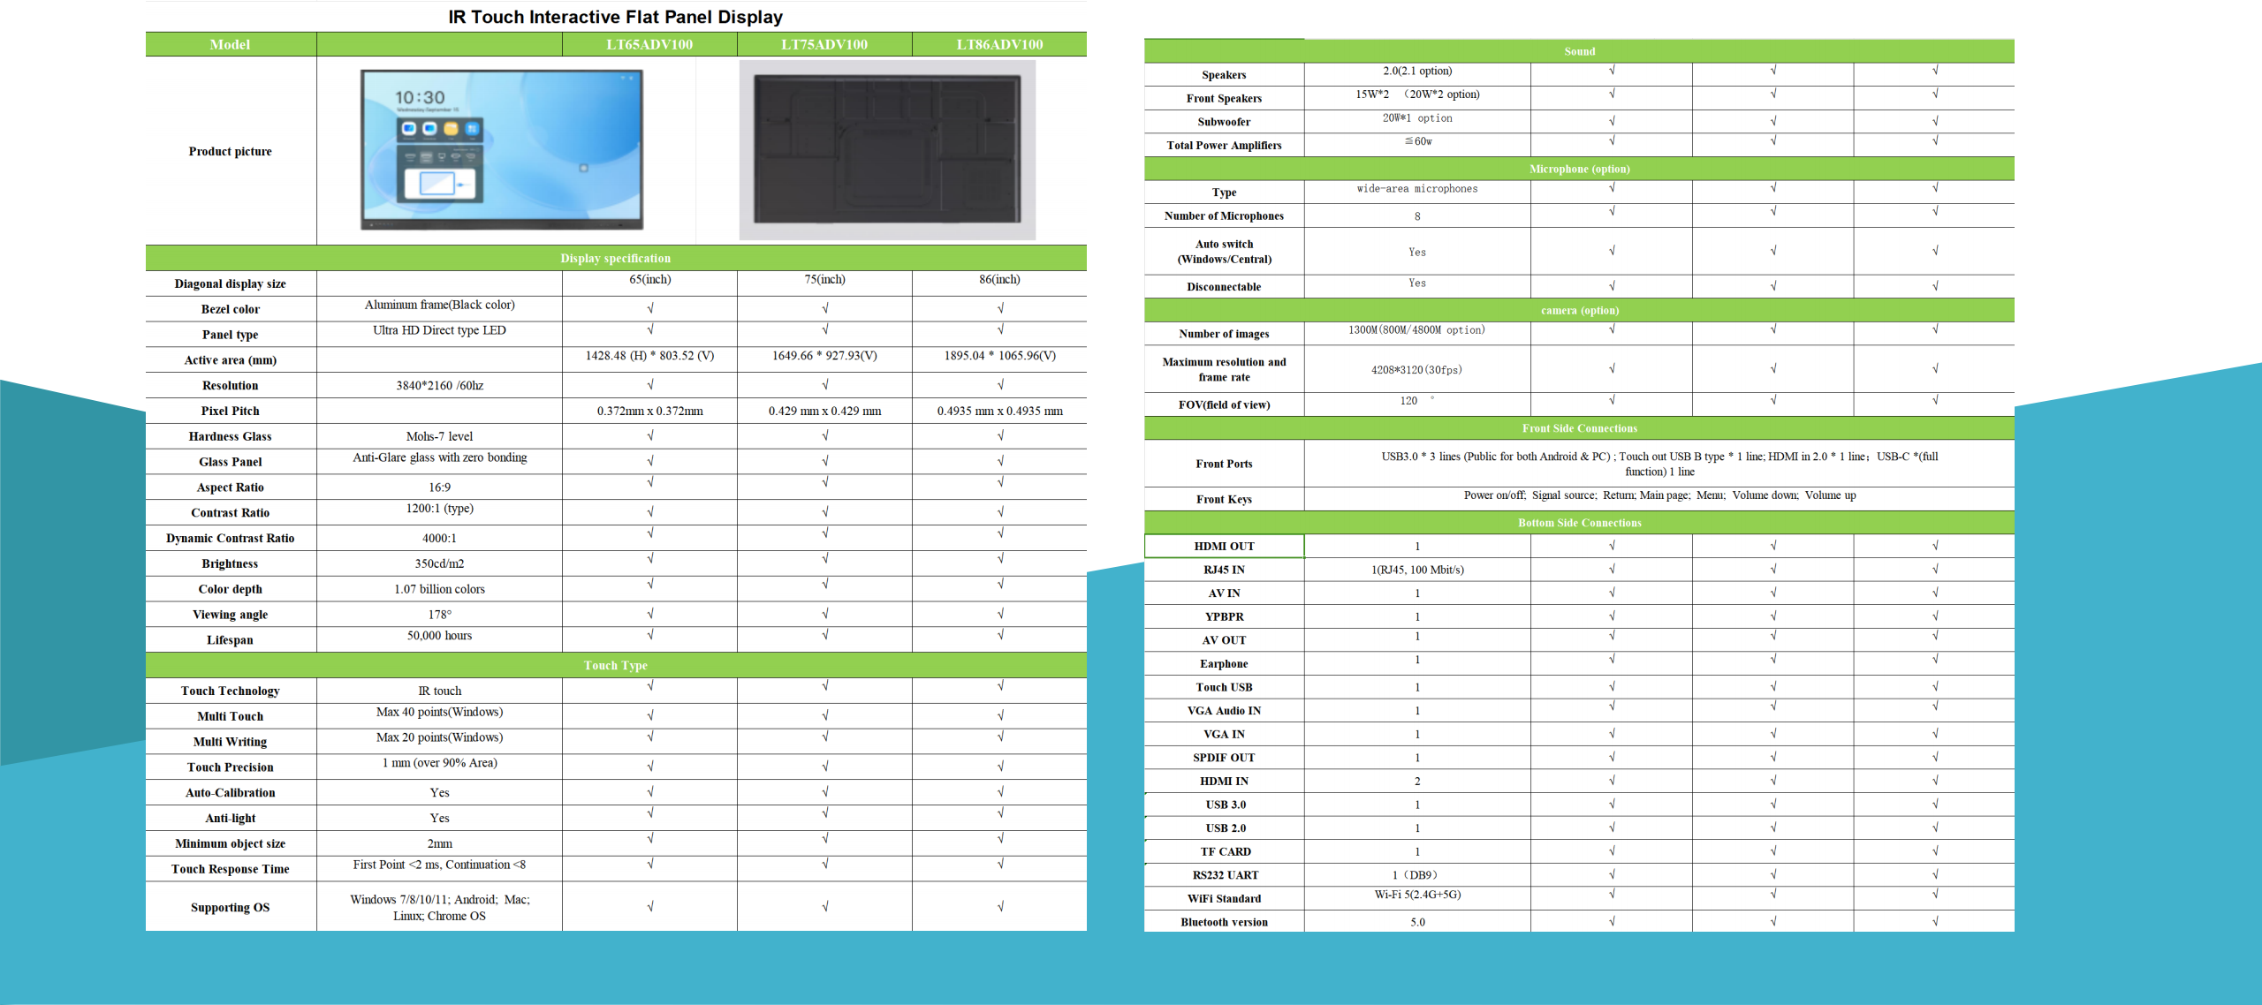
Interactive Flat Panel Display-ADV100

Slide 18
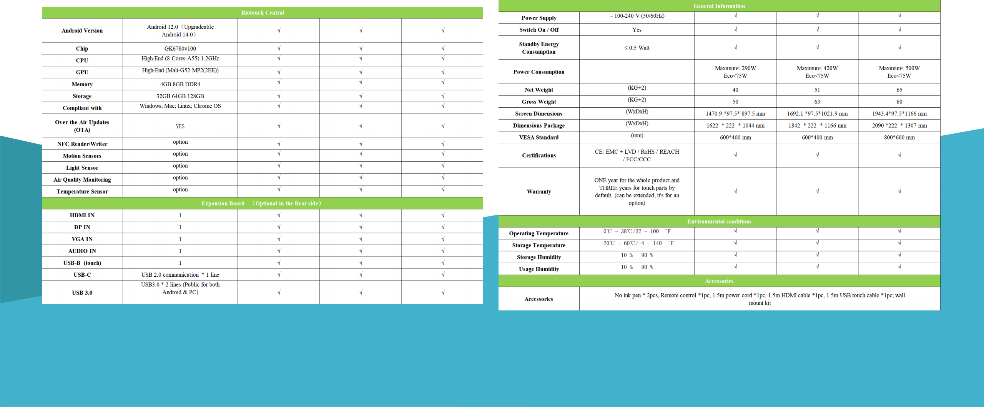
Interactive Flat Panel Display-ADV100

