Slide 1
“KC Sample cost set-off” / “KC 인증비용 상계＂
IFPD & OPS KC
전자칠판과 OPS KC

Slide 2
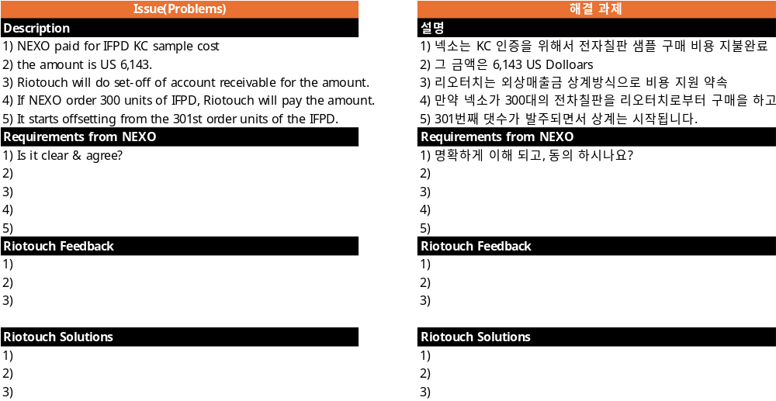
Requirements for“KC cost set-off”
Requirements #1 IFPD KC sample cost set-off

Slide 3
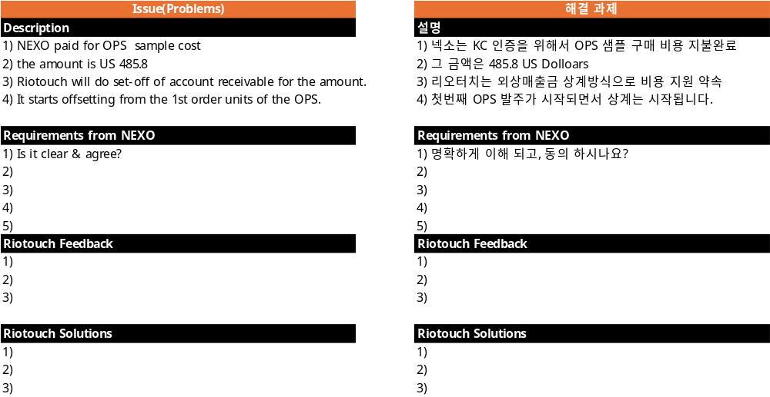
Requirements for“KC cost set-off”
Requirements #1 OPS KC sample cost set-off

Slide 4
Appendix(첨부)

Slide 5
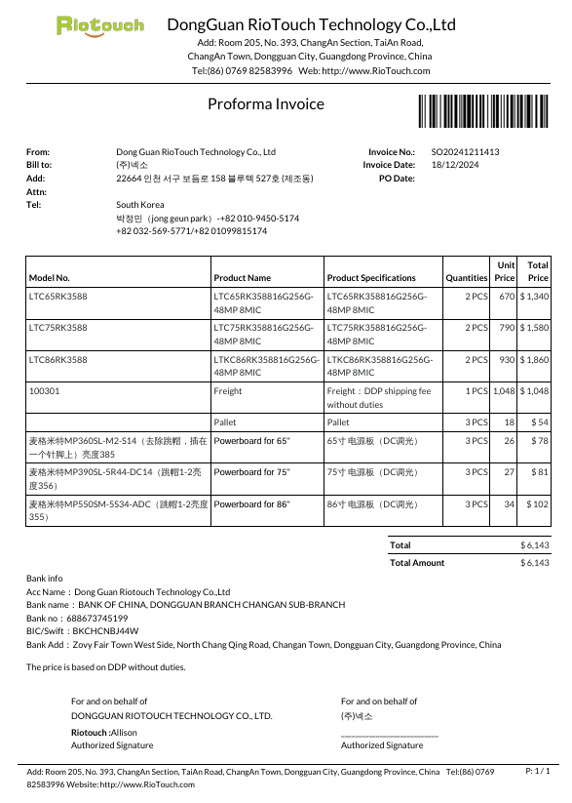
IFPD KC Sample Purchasing
US $ 6,143

Slide 6
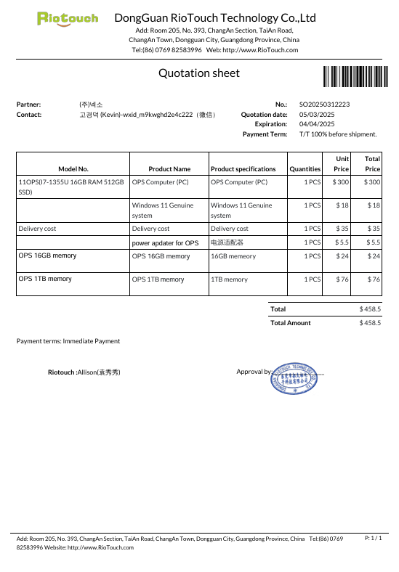
OPS KC Sample Purchasing
US $ 458.5

Slide 7
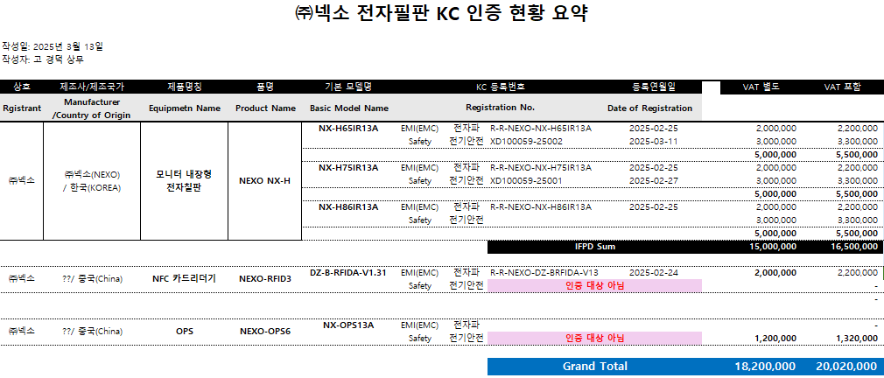

Slide 8
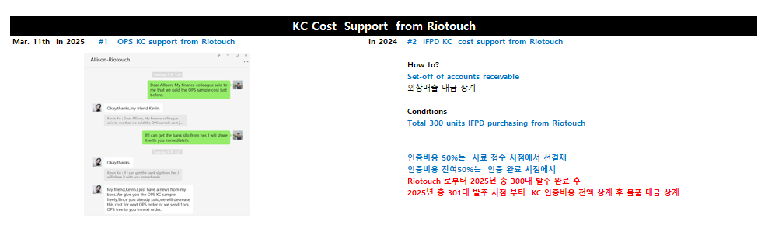

Slide 9
