Slide 1
“Cables Change” / “케이블 변경＂
HDMI , USB Touch, Power Cable Change
HDMI, USB Touch, 파워 케이블 길이 변경

Slide 2
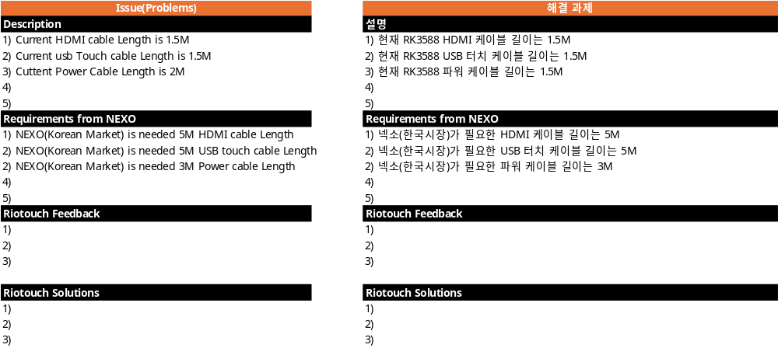
Requirements for “PP Plastics”
Requirements #1 Change from PE Plastics to PP Plastics

Slide 3
Appendix(첨부)

Slide 4
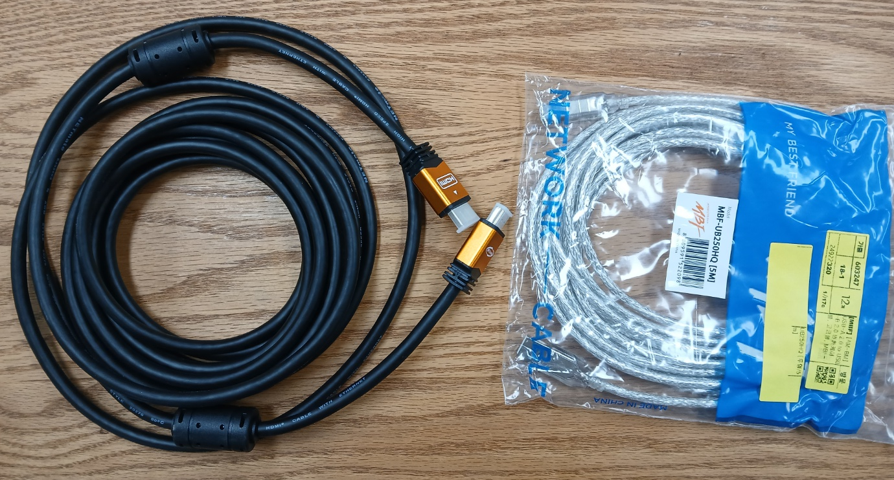
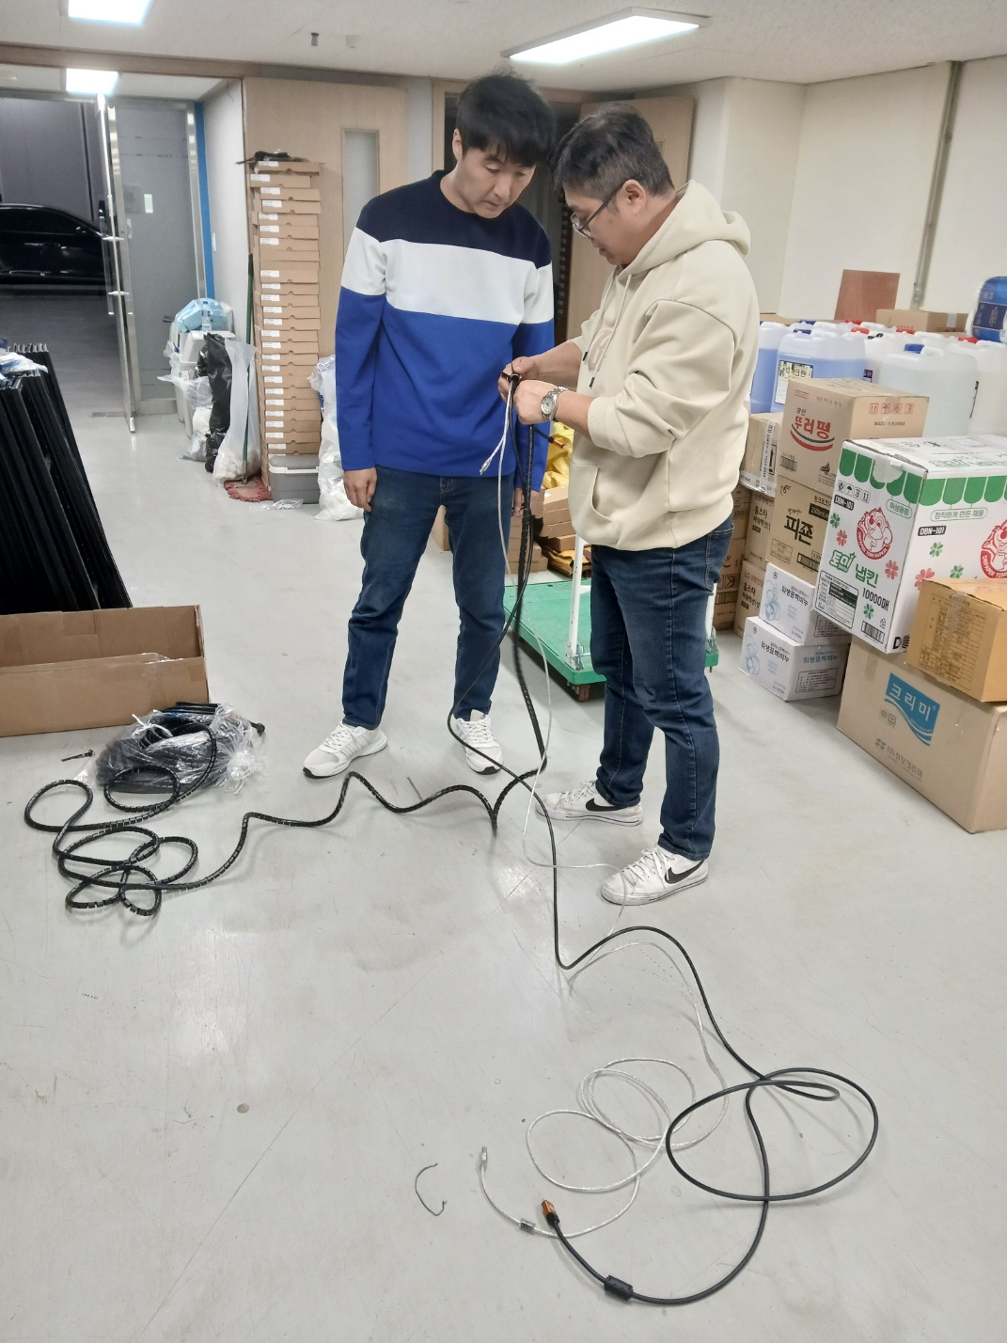
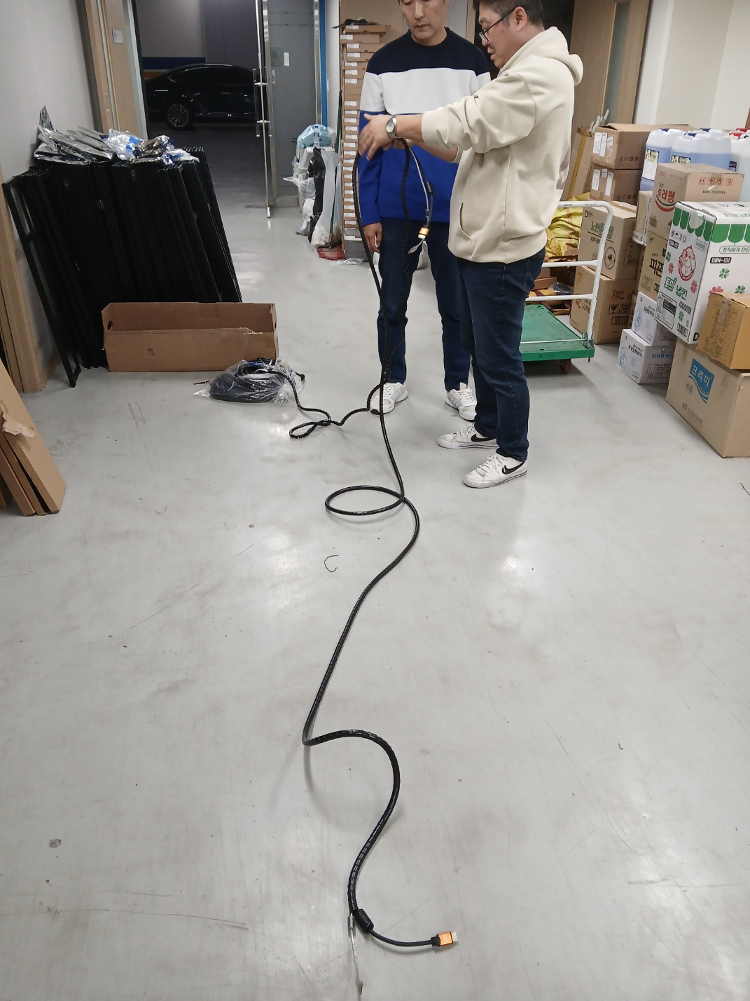
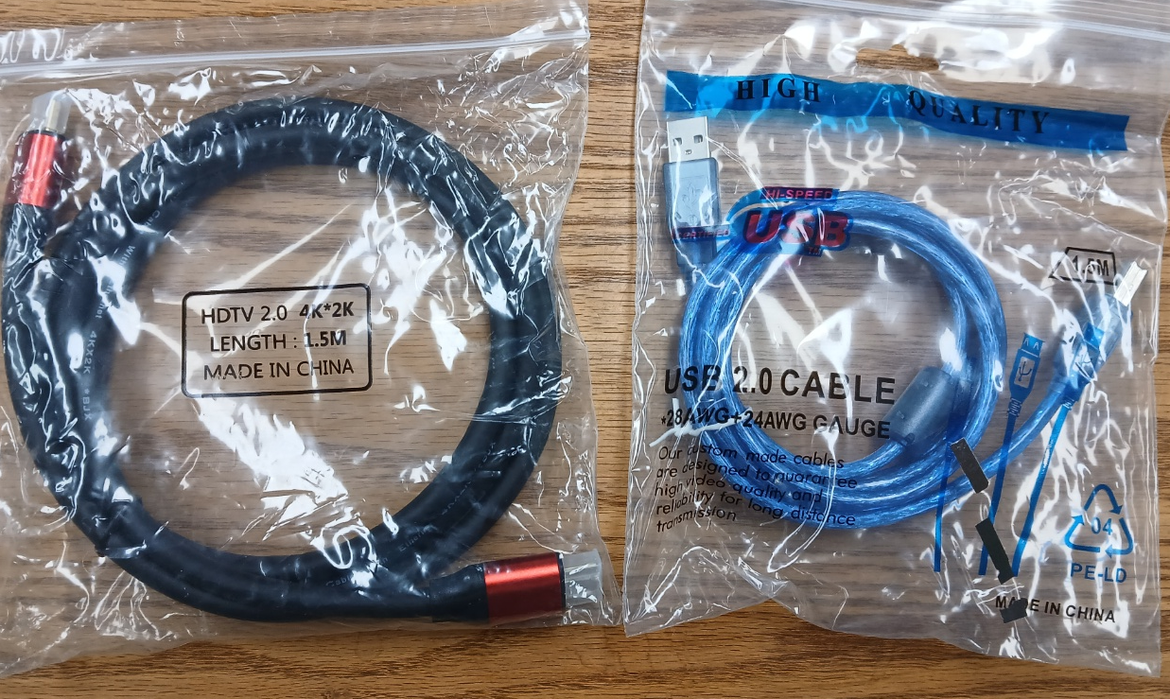
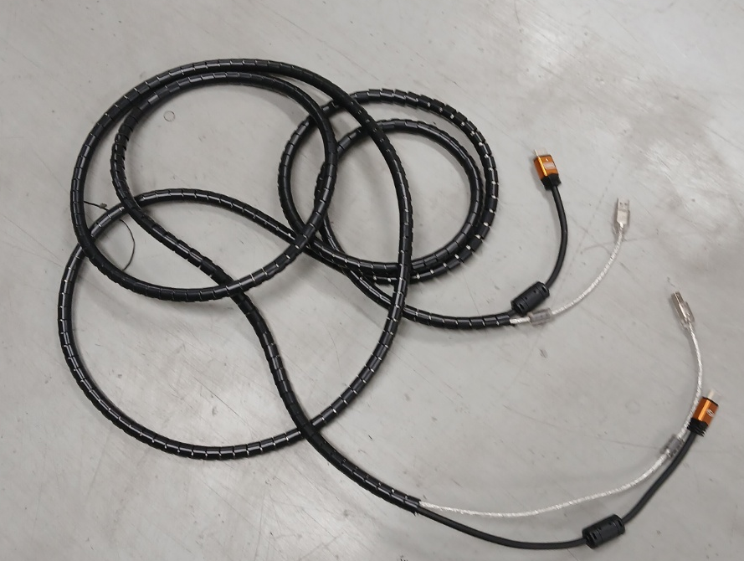
Request for Improvement 개선요청사항
Essential Additional Works
for IFPD Delivery in Nexo
About HDMI Cables , USB touch & Power cables
HDMI 케이블, USB 터치 및 전원 케이블 관련
Purchasing 5m cables per IFPD Box newly
Category 구분 | Riotouch |  | CVTe
 | As-Is | To-Be
HDMI Cables | 1.5M (2.0 version) | 5M(2.0 version) | 3M(2.0 version)
USB Touch Cables | 1.5M(2.0 version) | 5M(2.0 version) | 3M(2.0 version)
Power Cables | 2M | 3M | 3M
Making a 5m cables set per IFPD Box newly
Riotouch Cables in the IFPD Box of Riotouch
Providing 5m cables set per IFPD
for customers

