Slide 1
“4K 칠판”
Whiteboard Software
developed by Dazzle View

Slide 2
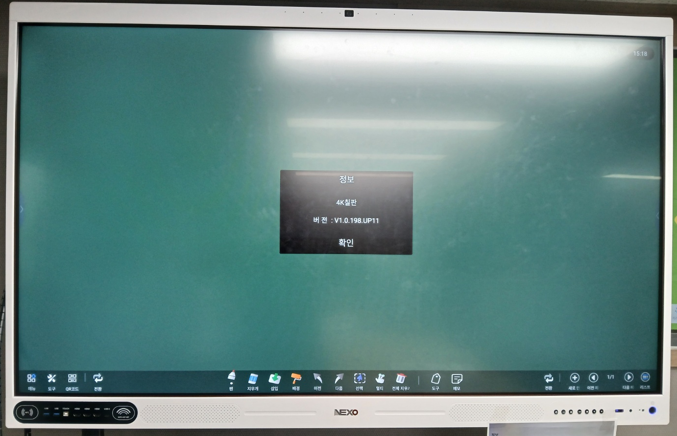
“4K 칠판” APP

Slide 3
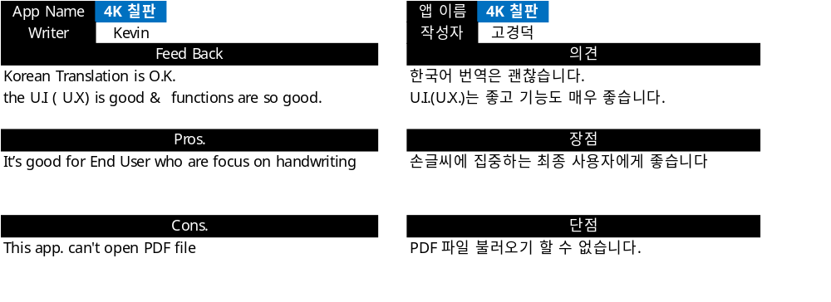
“4K 칠판” APP Test Feedback
General

Slide 4
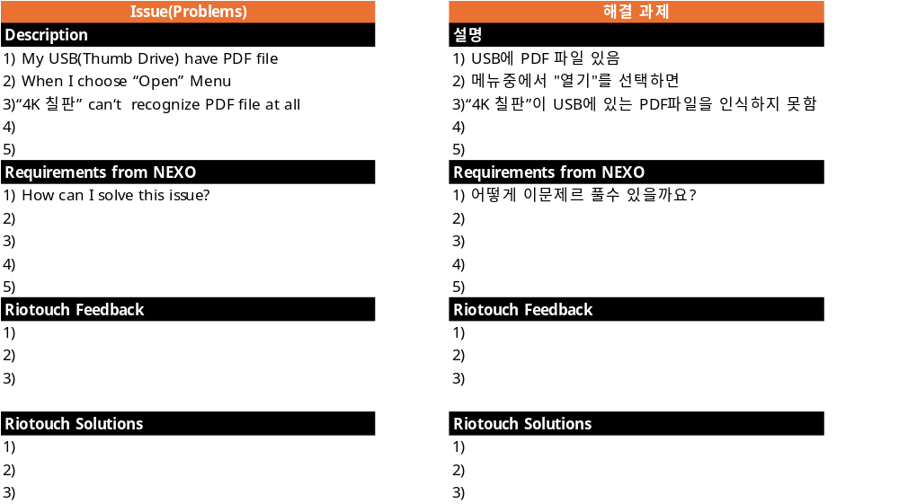
Requirements for“4K 칠판” APP.
Requirements #1 Can’t open PDF file

Slide 5
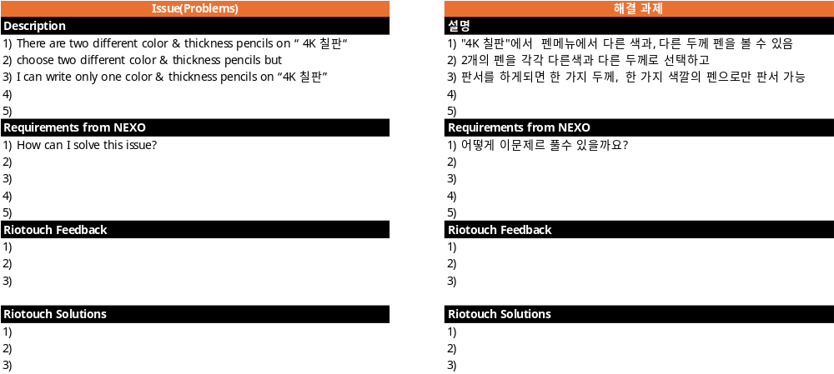
Requirements for“4K 칠판” APP.
Requirements #2 Pencil selection is not working.

Slide 6
Appendix(첨부)

Slide 7
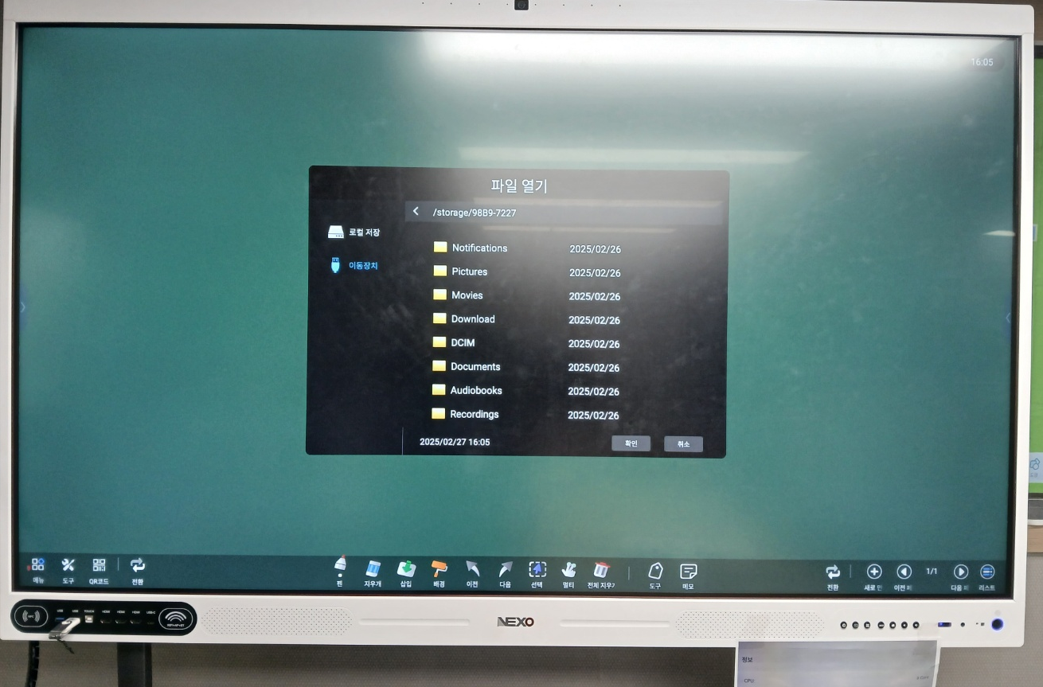
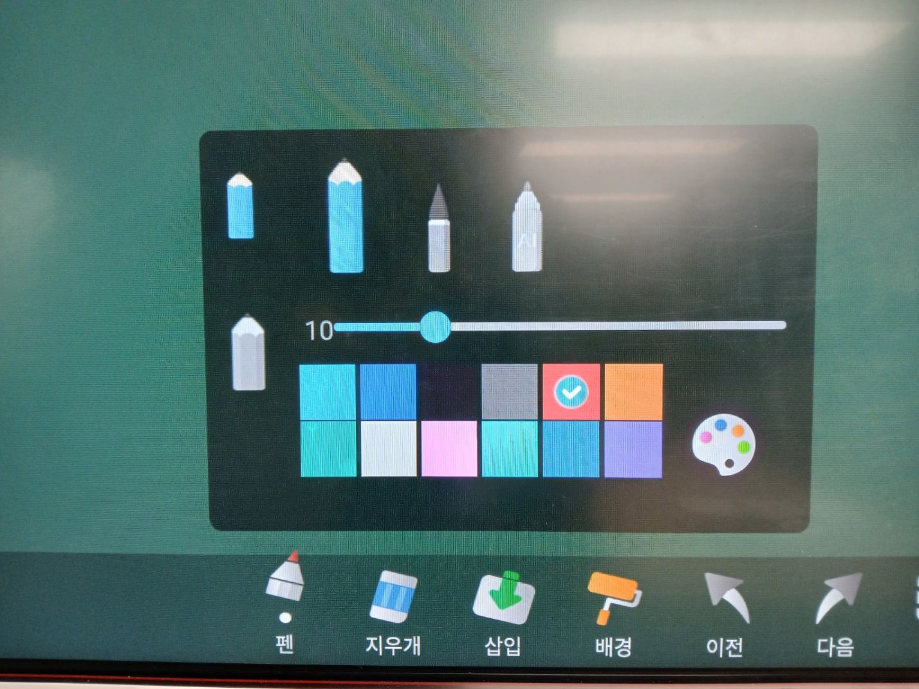
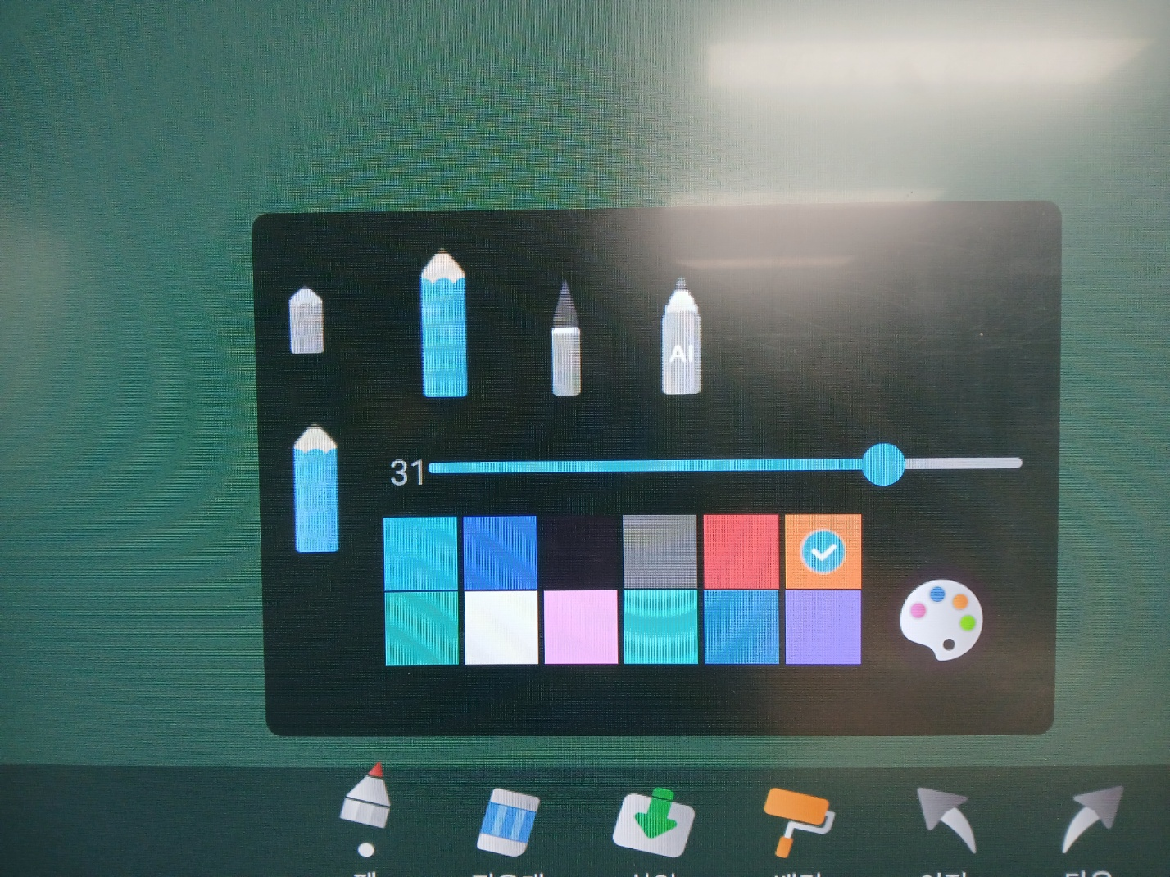
Requirements for“4K 칠판” APP.
Can’t Open PDF File
  My USB(Thumb Drive) have PDF file
  When I choose “Open” Menu
  “4K 칠판” can‘t recognize PDF file at all
  How can I solve this issue?
Pencil selection is not working.
  There are two different color & thickness pencils on “ 4K 칠판“
  I choose two different color & thickness pencils but
  I can write only one color & thickness pencils on “4K 칠판”
  How can I solve this issue?

