Slide 1
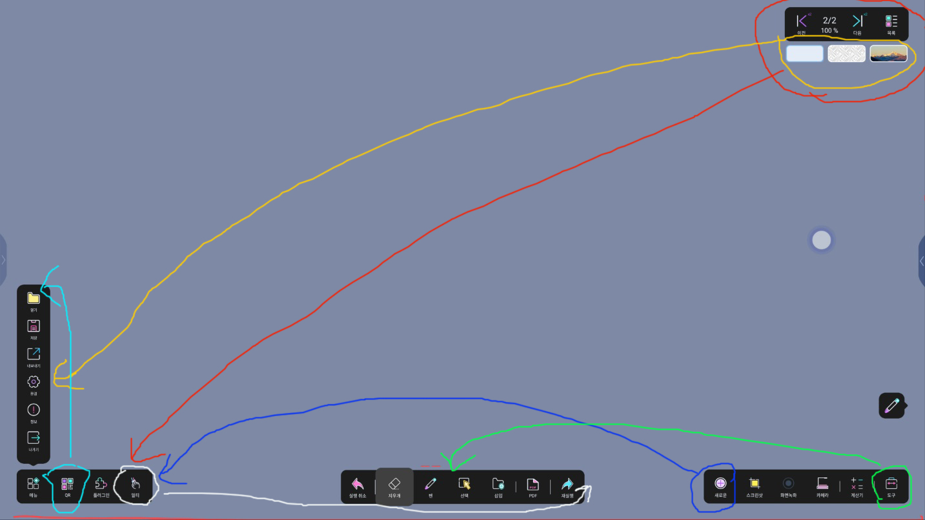
1
3
3
4
d
AS-Is
Make a empty space here
Background color change (Yellow Line)
  must go inside Setting
  If click Setting, and then appear
  the background change menu
Black Color bar(Page list, Previous page, Next page)
  Move to Left Bottom Black Color Bar(Red Line)
QR code move into Inside
“새 페이지” Icon move to Left Black Bar(Blue line)
“도구” Icon move to Center Black Bar
Multi Icon move to center black bar

Slide 2
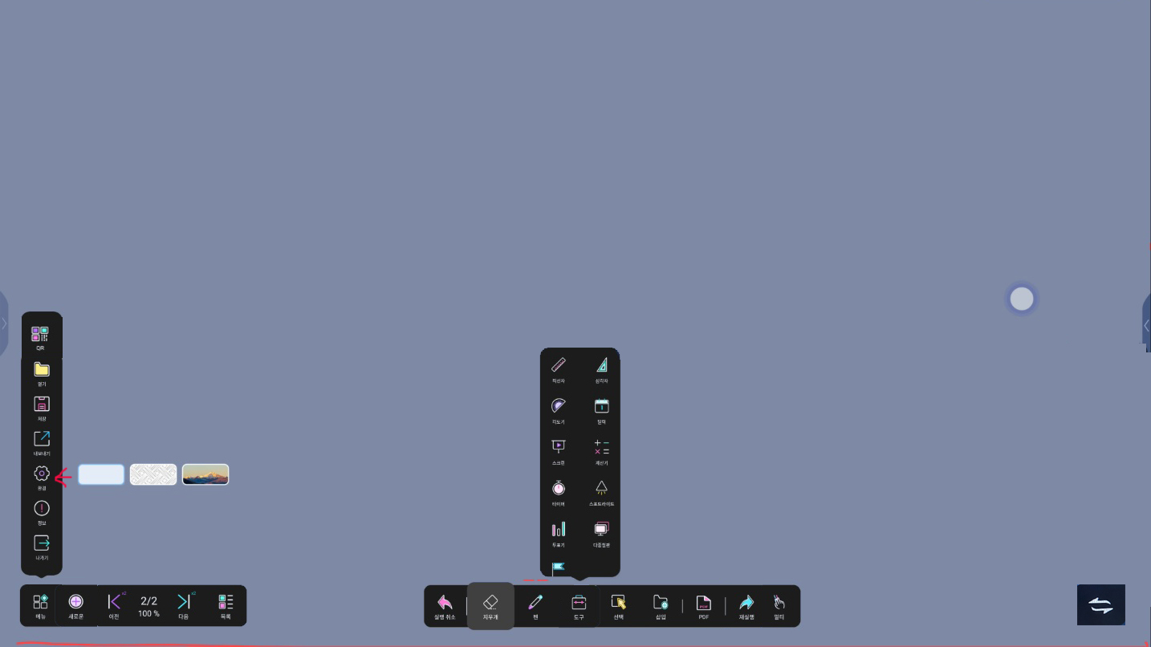

“Newly Added Icon”
this button is
For change Left Black Bar Location
Click one time and then move to
From Left to Right and then
Click one more time and then move to
From Right to Left Repeatedly
To-be

