Slide 1
“Idea & Proposal for UI UX convenience ”
“UI UX 편의성을 위한 아이디어 및 제안”
English
Korean

Slide 2
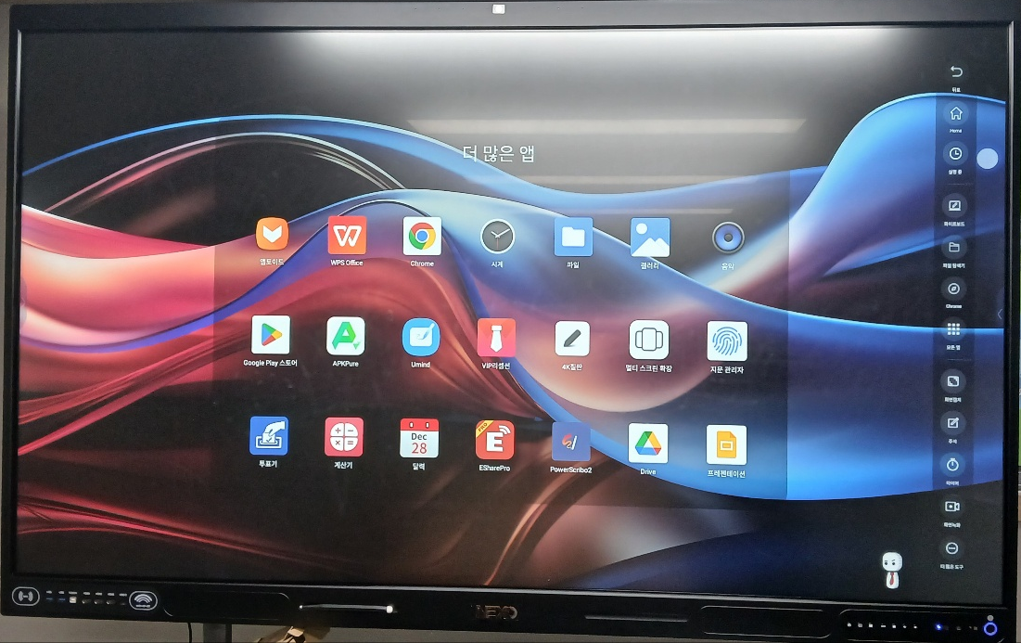
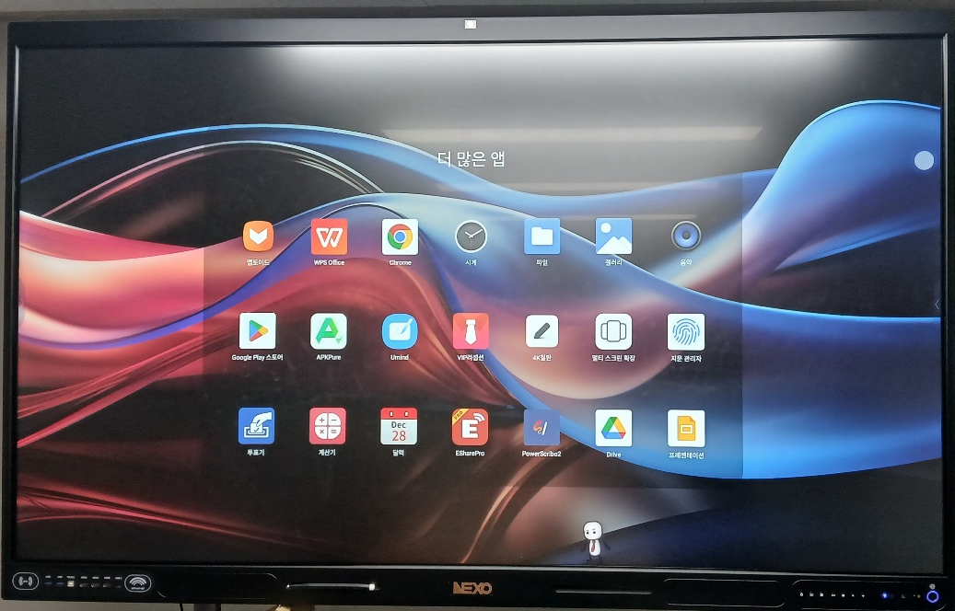

About “ how to return to Home Screen“
Easy and convenient return to “Home Screen” in “More App”
  “더 많은 앱”에서 쉽고 편리하게 “홈 화면”으로 돌아가기
To-Be
As-is
If customers click or touch anywhere on Screen
by Pen or Finger
They can go back to “Home Screen”
Customers must click side bar first & click “Home” icon
And then they can go back “Home Screen”.

Slide 3
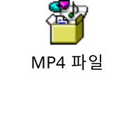
About “Left side Bar is not working on RK3588 75inch”
I can’t click “Left Side Bar”
“Left Side Bar” can’t move up or down in the Screen
“Right Side Bar is working well without any problems
  Can Click
  Can move up or going down well
Please double click & open the above red icon,
and what the video clip for your clearer understanding

Slide 4
Appendix(첨부)

