Slide 1
“Recognize the IFPD Pen touch ”
“전자 칠판 펜 터치 인식”
English
Korean

Slide 2
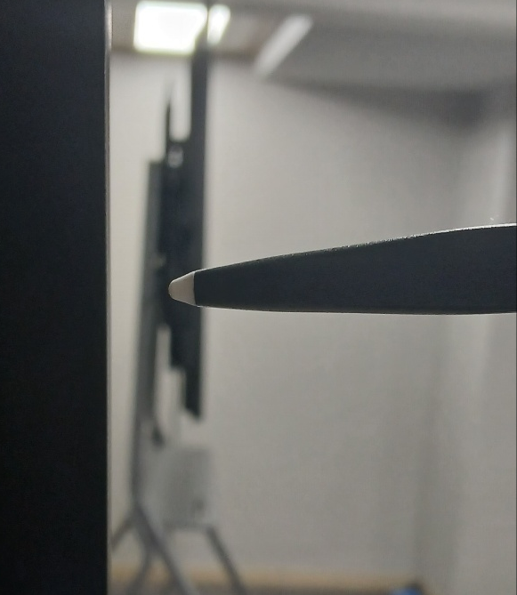
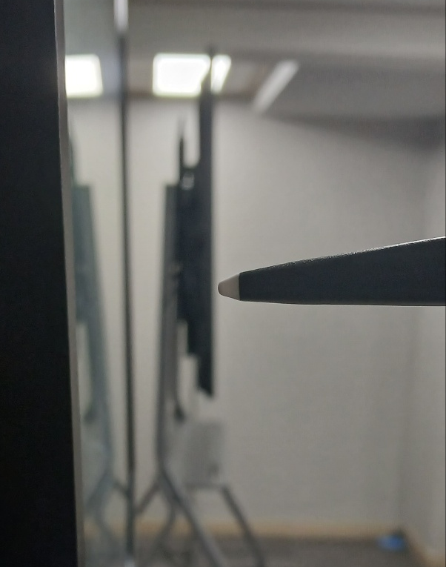
About “ Pen touch issues of current IFPD
Issue from The IFPD currently sold by NEXO
a new product
that is being sold as a replacement
for an existing product
Existing Model
Product Change
Improvement of Recognize
Distance for the Pen touch
1mm
3mm
Existing IFPD Model’s pen touch
& recognitions are better than New IFPD Model.
Voice of Customers
New Product Model’s Pen Touch quality
& recognitions are better.
Customers can feel uncomfortable than
When they writing on existing IFPD Model.
It cannot modify this feeling with the software because of that the reason is coming from Hardware.
Manufacturer's feedback

Slide 3
About “ Pen touch issues of current IFPD
Question for RK3588 IFPD about Pen touch & Recognition
1mm
3mm
What is the Pen touch Rcognitions distance for RK3588?
  1mm?
  3mm?
  more than 4mm?
Questions for the Pen touch &
Recognitions from NEXO
2. If it is more than 2mm,
Can Riotouch modify this uncomfortable & not natural feeling with the software or software change?

Slide 4
Appendix(첨부)

