Slide 1
“ Let’s make a simple Power Off”
“간단한 전원 끄기”
English
Korean

Slide 2
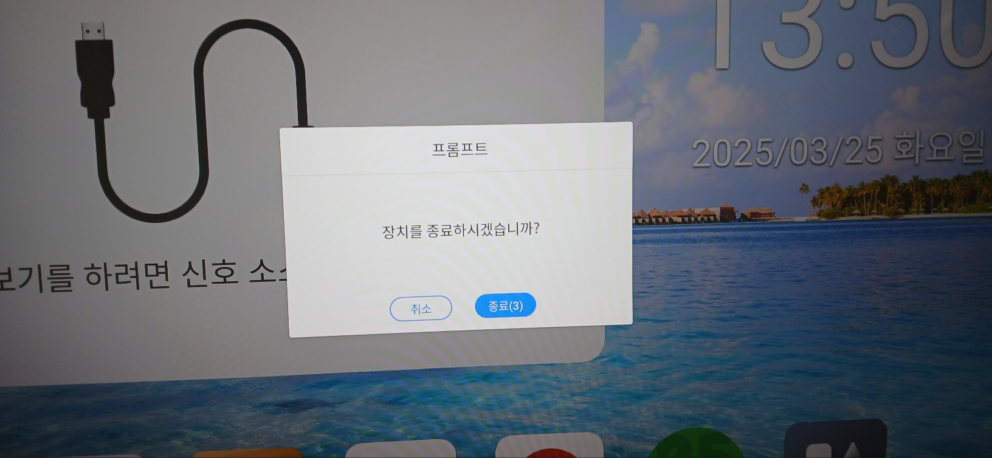
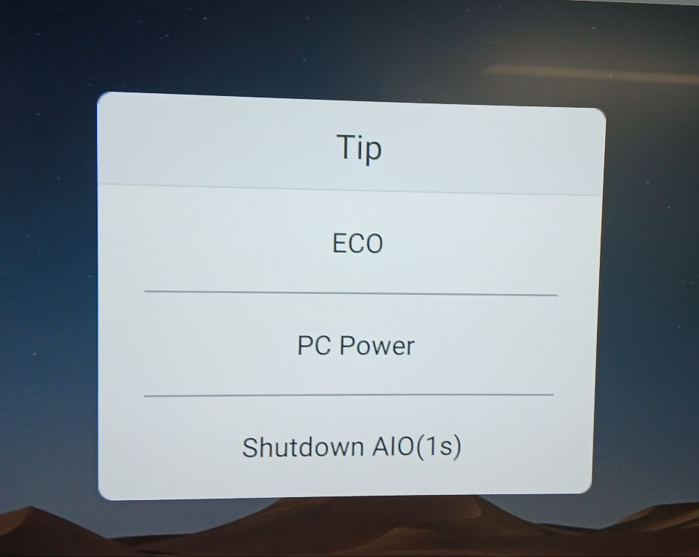
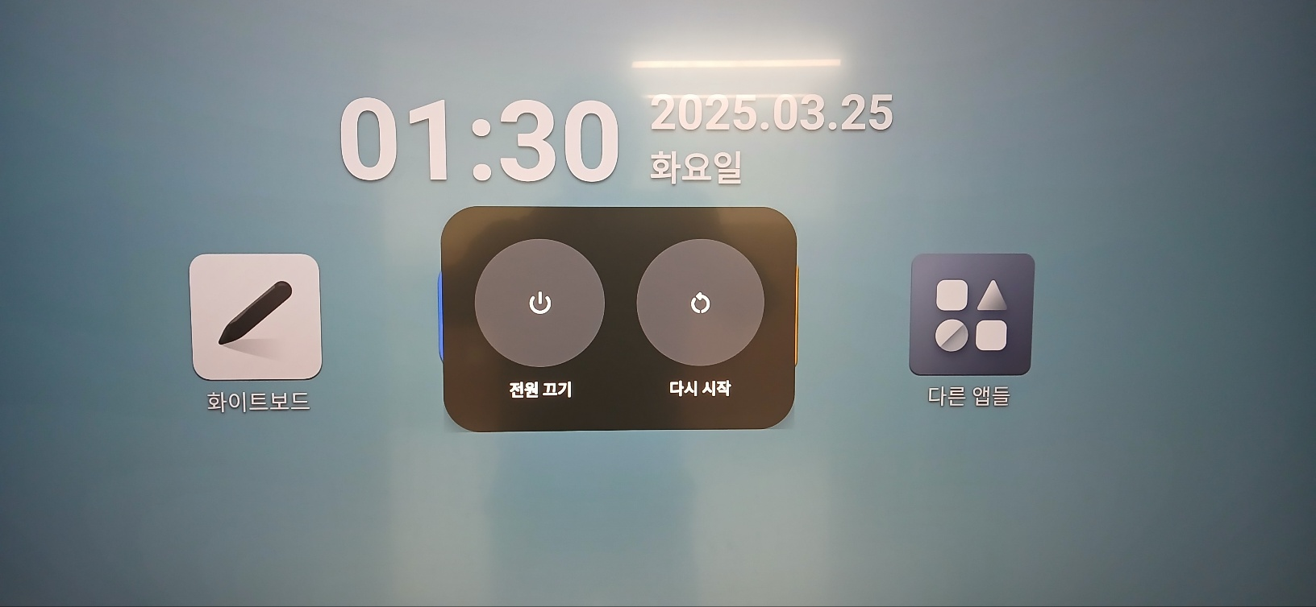
About “ Power Off Mode“
Power off on RK 3588 Power Off on Competitors
Do you want power off?
Please Make
a simple
Cancel
Power off
Power off
Too many options for Power off
Need Korean Translations
Power off
Restart

Slide 3
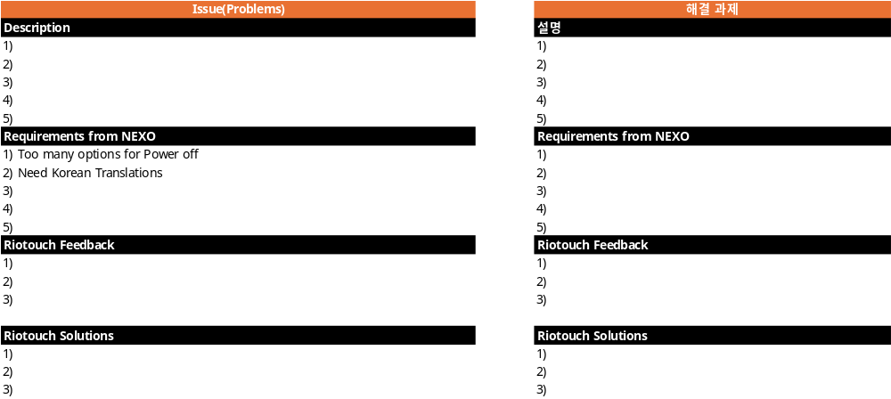
Requirements : “Let’s make a simple Power Off Options ”
Requirements #1 simple power off options

Slide 4
Appendix(첨부)

