Slide 1
“ add or disappear setting function for Google Searching Icon on Home Screen”
“홈 화면에서 Google 검색 아이콘에 대한 설정 기능 추가 또는 삭제”
English
Korean

Slide 2
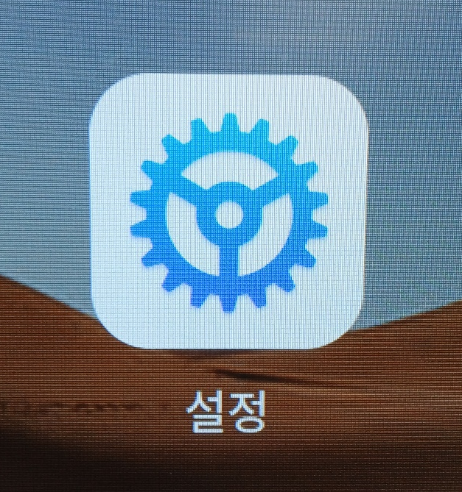
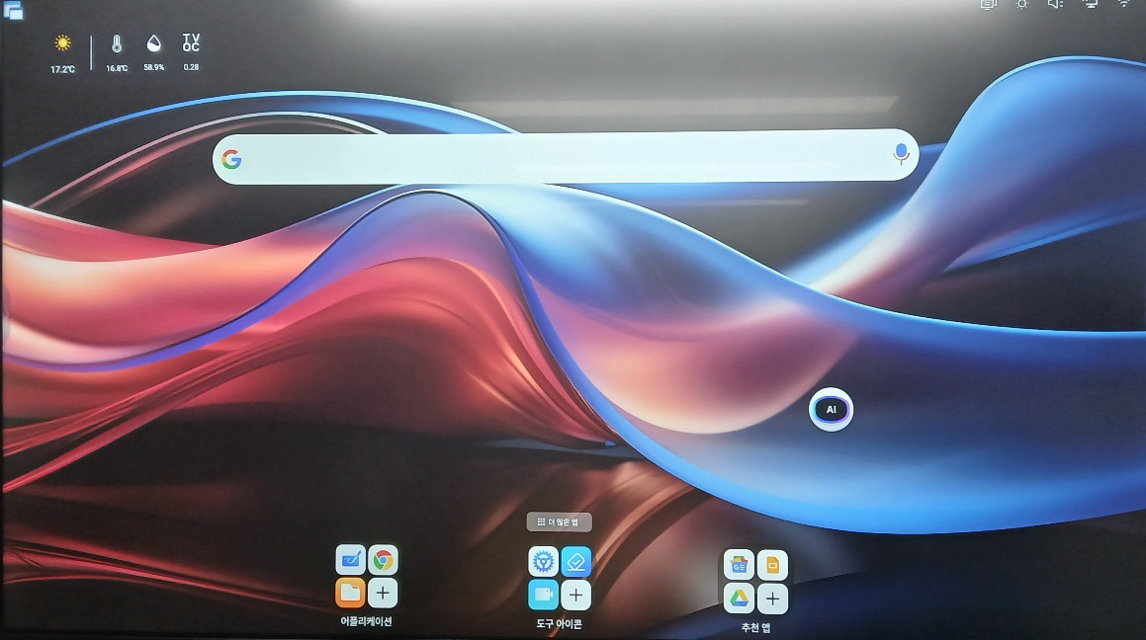
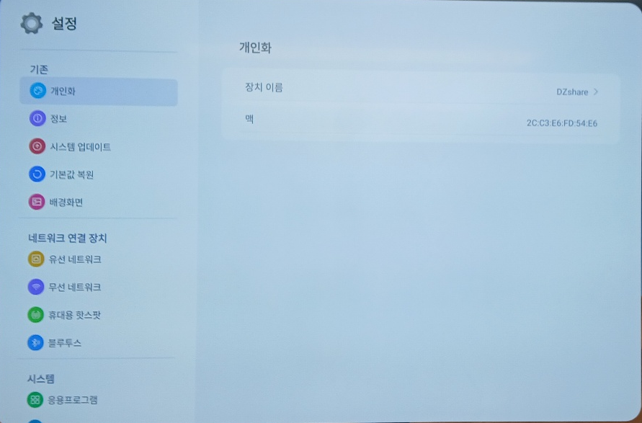
About “Google Searching Icon on Home Screen “
add or disappear setting function of “setting” Icon is needed.
  Reasons why?
    NEXO usually provide Customer’s Full-Size Logo on the center of Home Screen
Appeared
Disappeared
Click Setting Icon
Go setting Detail
Google Searching Icon
Active
Inactive
Disappeared
Appeared

Slide 3
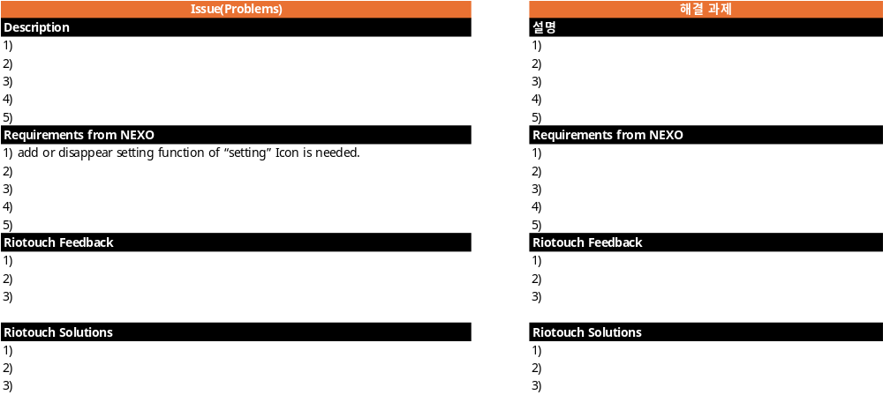
Requirements : “Google Searching Icon on Home Screen ”
Requirements #1 add or disappear setting function of “setting” Icon is needed.

Slide 4
Appendix(첨부)

