Slide 1
“ Application Display Change of RK3588 Launcher”
“ RK3588 런처의 애플리케이션 디스플레이 변경”
English
Korean

Slide 2
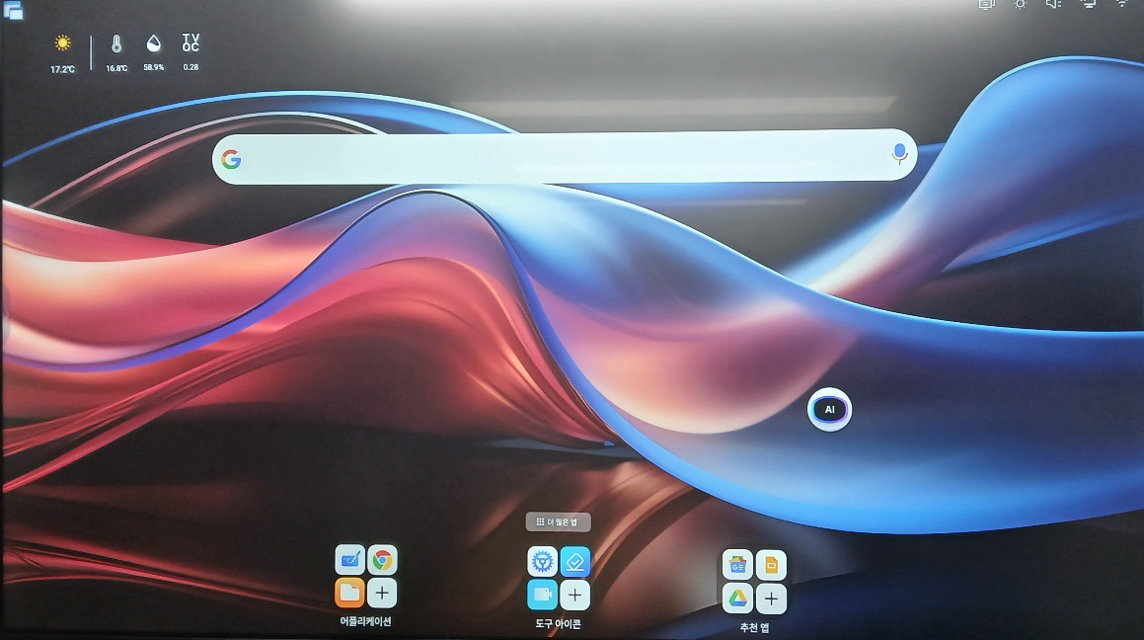


About “Application Display Change of RK3588 Launcher “
As- IS To-BE
#1 Please Change Application Display
How to manage App icon on “Home Screen”
How to delete specific App. Icon on “Home Screen”
If customers do long press one Application Icon on Launcher, Can get rid of it.
How to Add specific App. Icon on “Home Screen”
If customers press one Application Icon on “More App”, Can add the icon on “Home Screen”

Slide 3
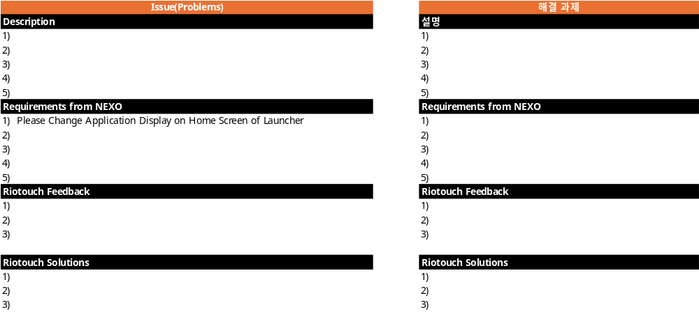
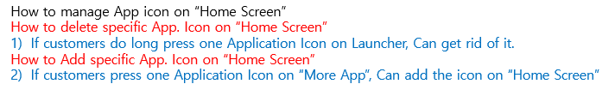
Requirements : “Application Display Change of RK3588 Launcher ”
Requirements #1 Application Display Change of RK3588 Launcher

Slide 4
Appendix(첨부)

