Slide 1

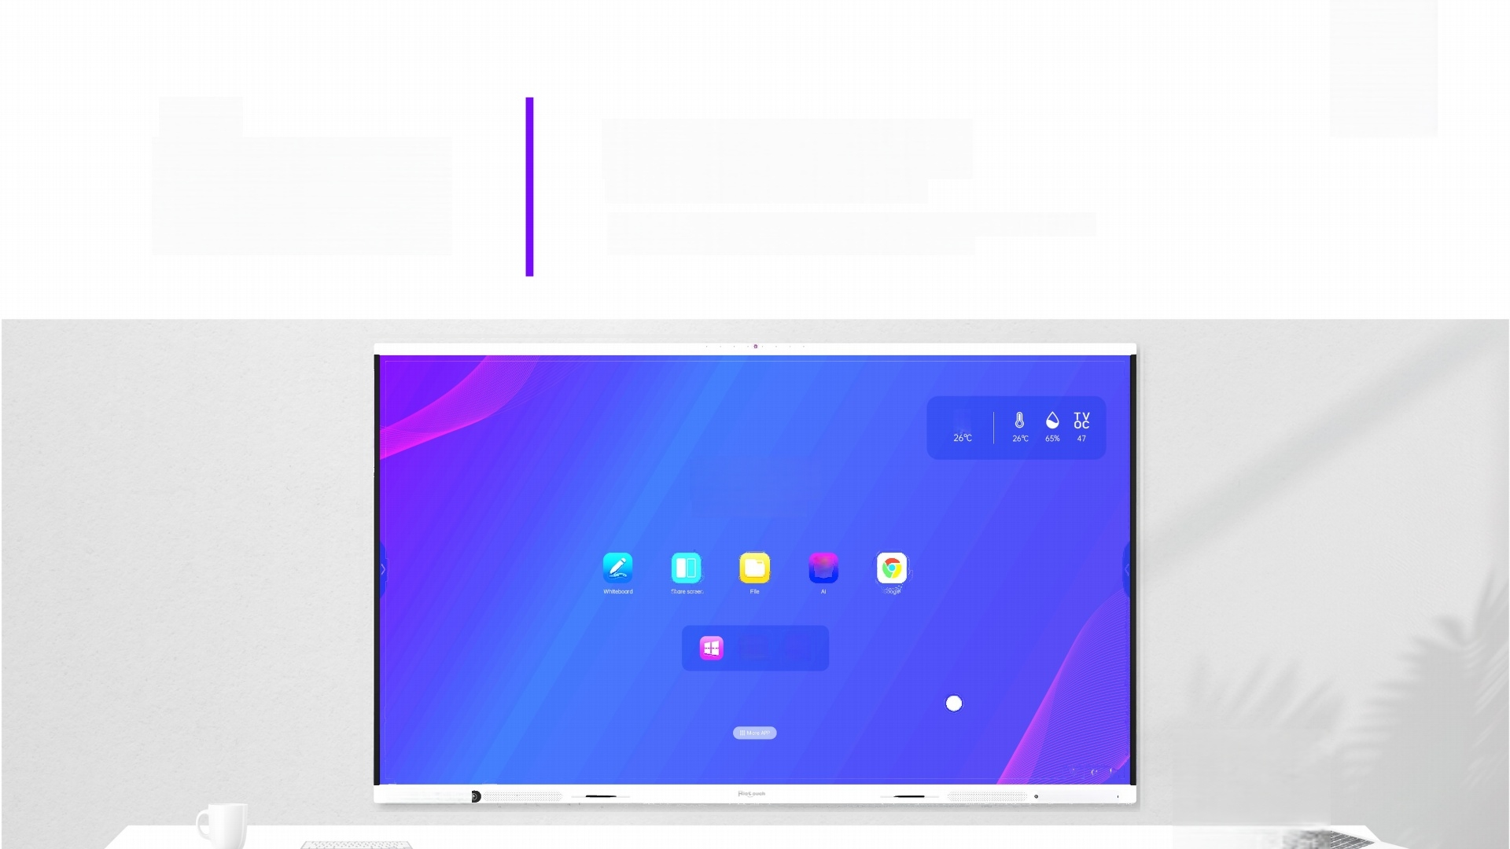

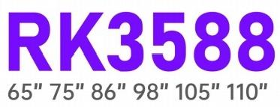
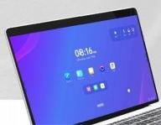
High-Performance,
meet Interaction
RK3588 interactive screen-Innovating learning and collaboration, redefining technology for education and business
*
08:16
Monday,April 15th
O
+
- …●

Slide 2

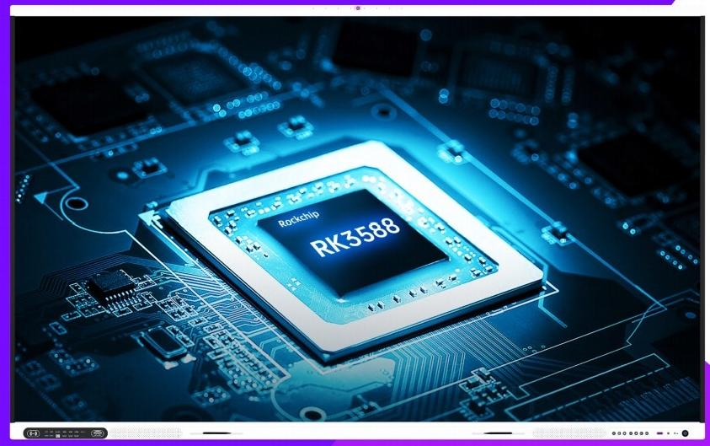






Best Performance Interactive Screen For Education And Business
8nm
Lithography Process
6Tops
Computing Power
Octa-core
CPU
8K Video
Video Decoding
EDLA
Experience the power of an intuitive app-based user interface that makes teamwork a breeze.Whether in the classroom or the boardroom,our robust whiteboard functionality allows for real-time sharing and brainstorming,taking your productivity to new heights.

Slide 3

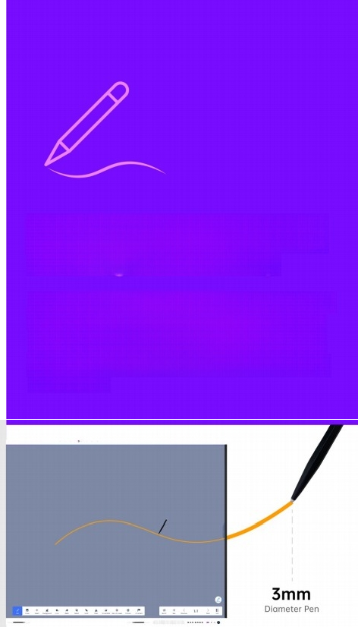
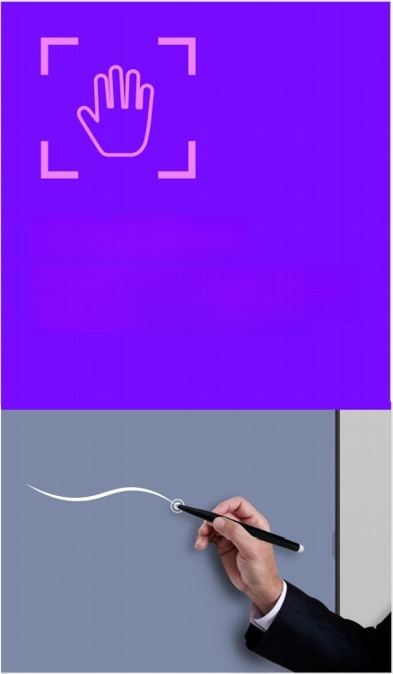
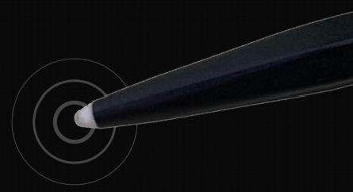
Naturally Smooth Writing with Digital Accuracy
Wite,annotate,and collaborate during presentations with a pen-on-paper feel.With dual-pen recognition to support group colloborotton,and Ultra Fine Touch technology and 3mm tipped pens for lag-free digital precision,offers unparalleled writing accuracy with a natural flow.
Palm Rejection
Palm recognition technology mintmizes errant touch inputs from palms,wrists,sleeves,etc.,so that users can write and annotate freely.
Touch
Up to 40 points of touch

Slide 4
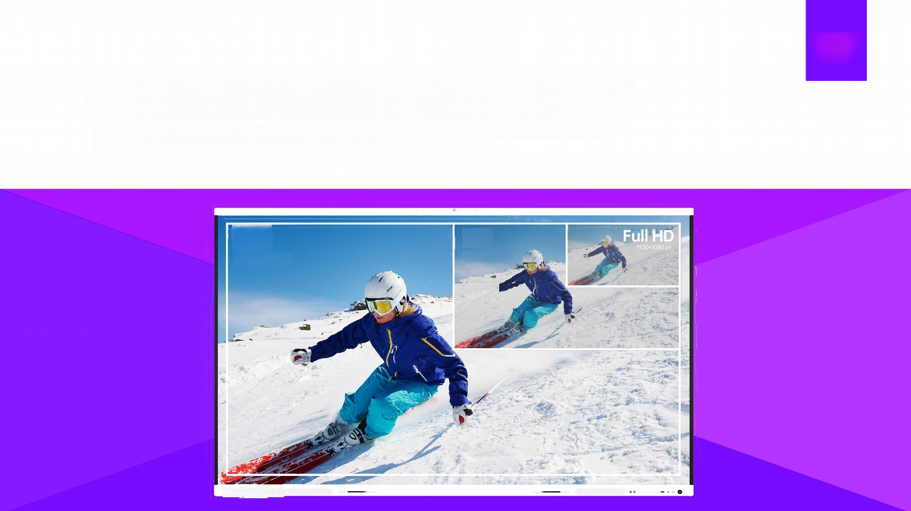
Riotoueh
More nteractive
8K Resolution With Immense Picture Quality
A dynamic display range has 8k video resolution with an unparalleled visual experience offer true to life color and
picture quality,enhances any classroom or meeting room experience and adds life to it.
8K
7680*4320 px
4K
3840×2160 px
0000

Slide 5
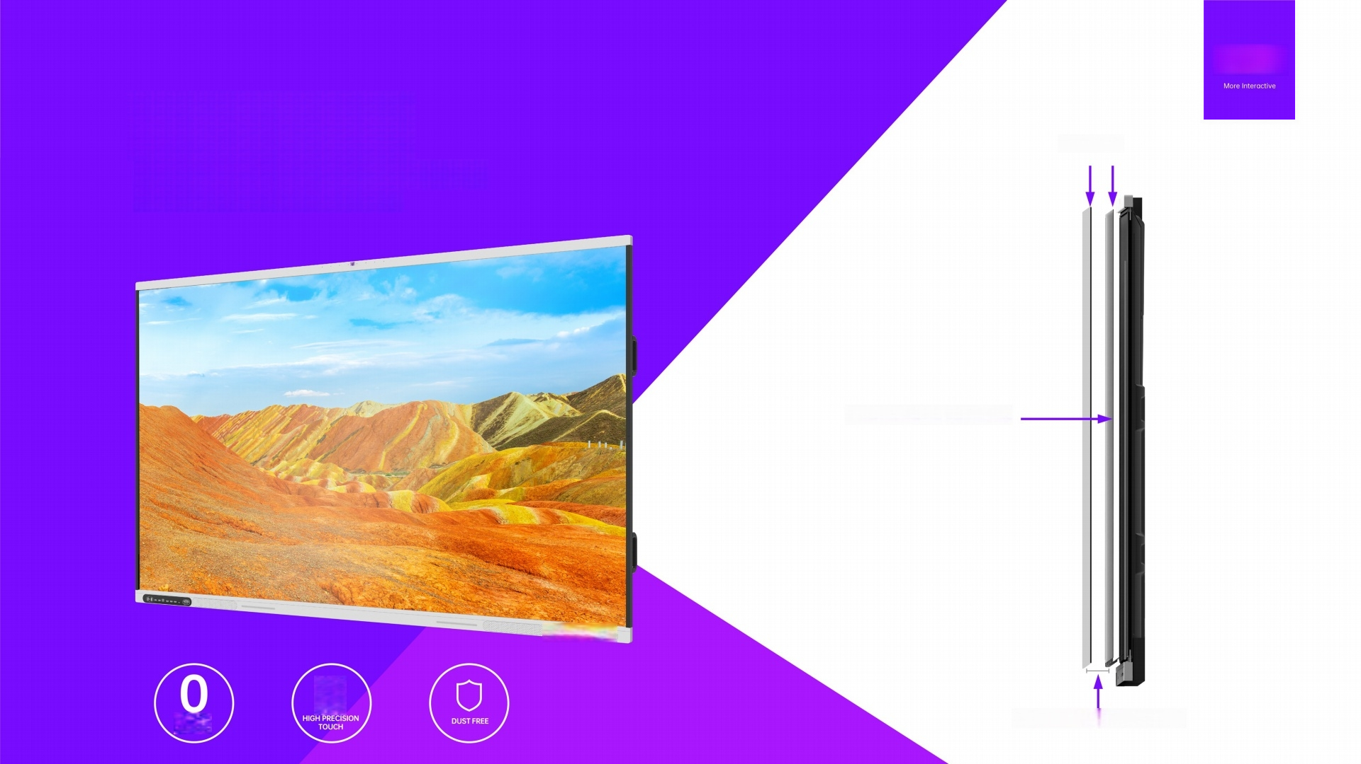
Zero Bonding
Zero boning technology ensures high precision touch and dust free clarity screens.
Glass OC
0mm Air Gap at the center
-
…●
见
BNERe
0.8mm Air Gap at the edge

Slide 6
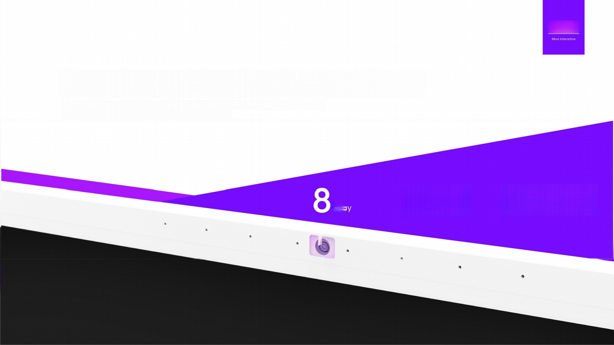

8Array Microphones with speaker tracking
8 microphones and speaker-tracking technology locate the sound source in real-time,
ensuring the speaker is always the center of attention.
8^{Array} 10^{-meter} Al^{noisereduction}

Slide 7
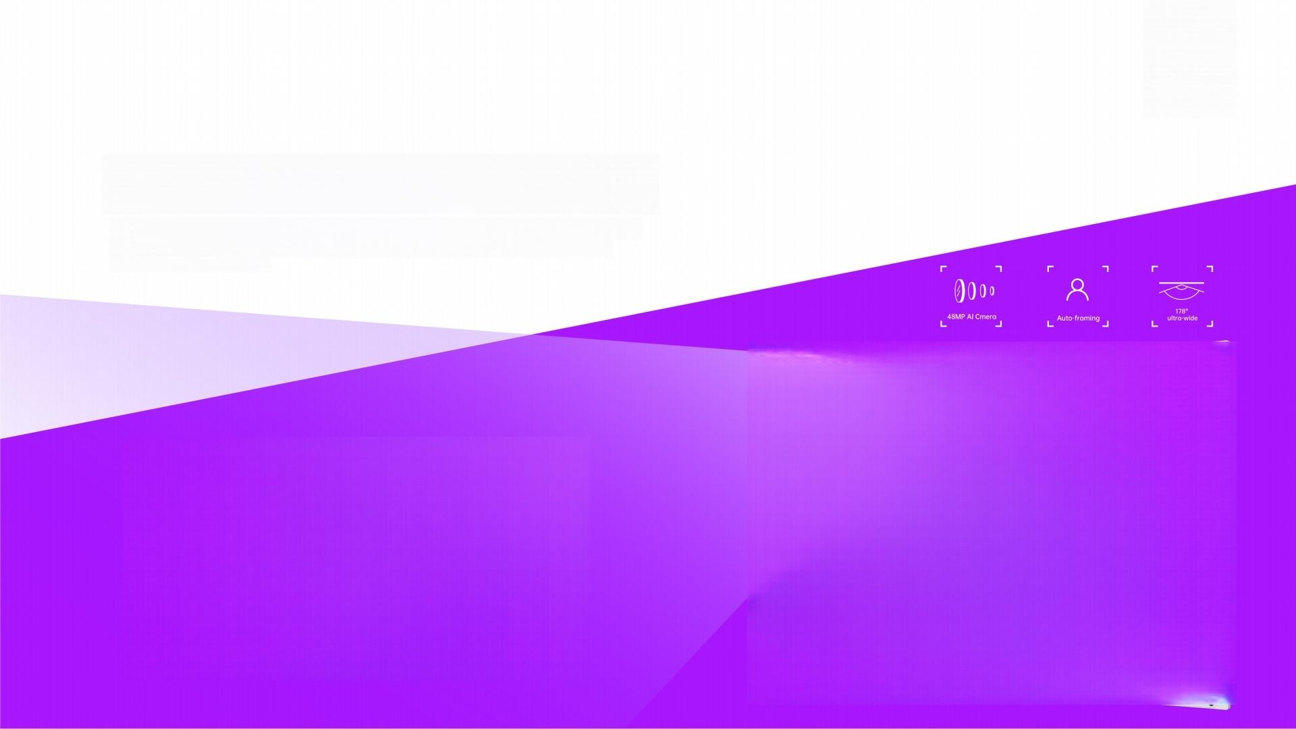



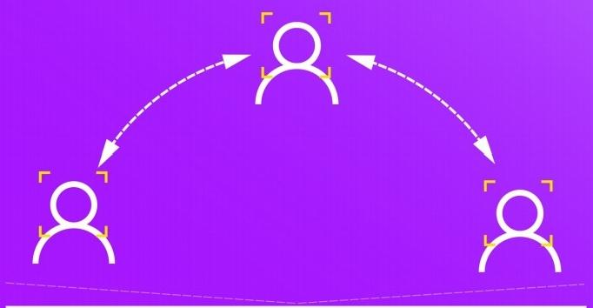
48MP AI Camera Auto framing
With auto-framing,the Riotouch display automatically adjusts to achieve the best angle based on the number of participants and their location,so it feels like a
face-to-face interaction.

Slide 8
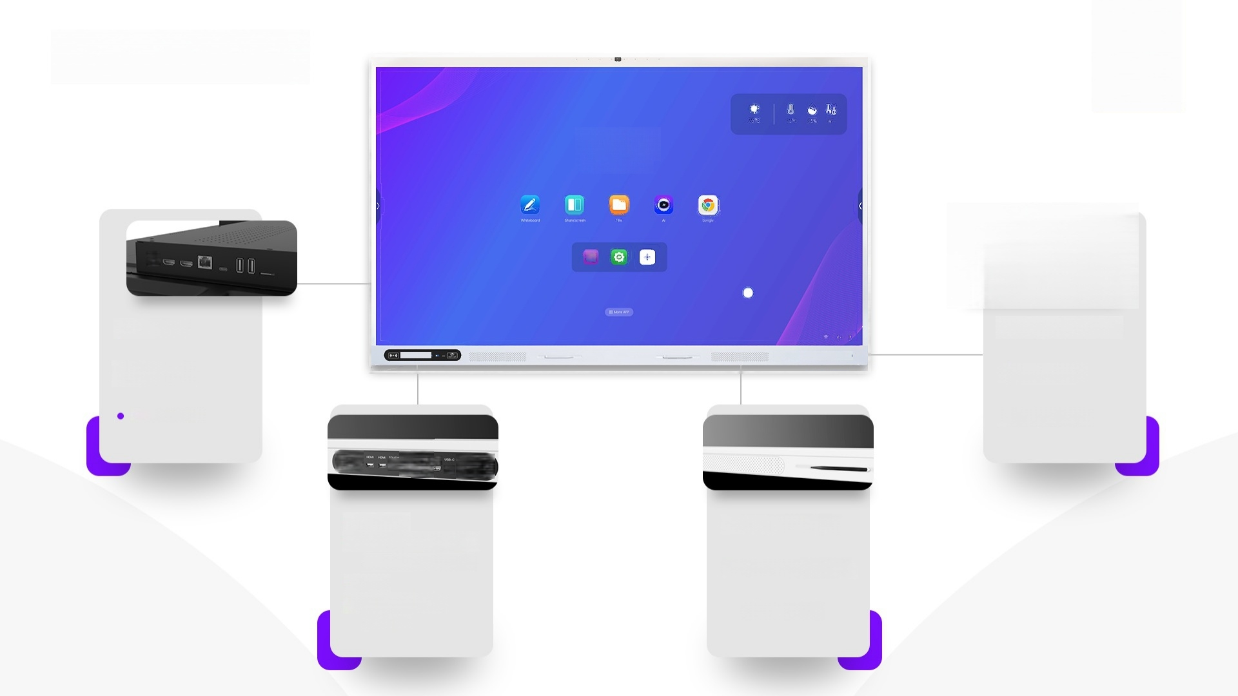
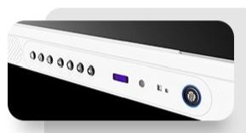
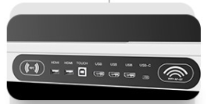
Multiple Ports
08:16
Mondtoy,April 15th
口
田
● HDMI OUT
● Type-C Out
Bluetooth 5.2
● Finger Print Module
● Light Sensor
· - ·O
● PM2.5 Sensor
● USB3.0
● USB-CIn(Multi media 65W/100W Optional)
● NFC
● WIFI 6,2.4G/5G
802.11ax
● Magnetic pen tray
● Front facing speakers
(20W optional)

Slide 9
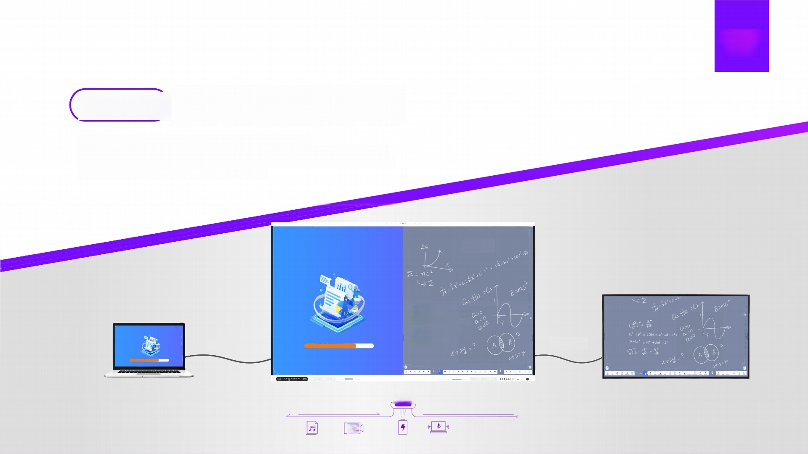

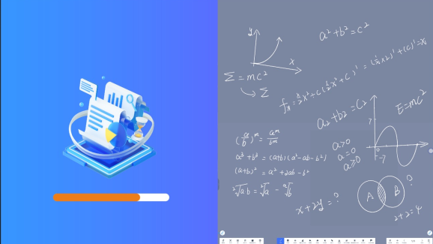
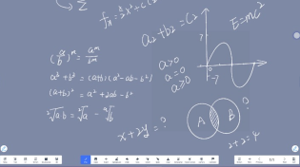
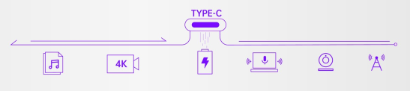
Versatile Connectivity
Experience seamless connectivity with the versatile Type-C port.
Effortlessly connect to webcams,microphones,speakers,USB flash drives,and wired
networks by simply plugging in a cable.And with up to 100W of charging performance,
your device stays poweredthroughout your lessons.
Type-c In
-Type-c Out

Slide 10
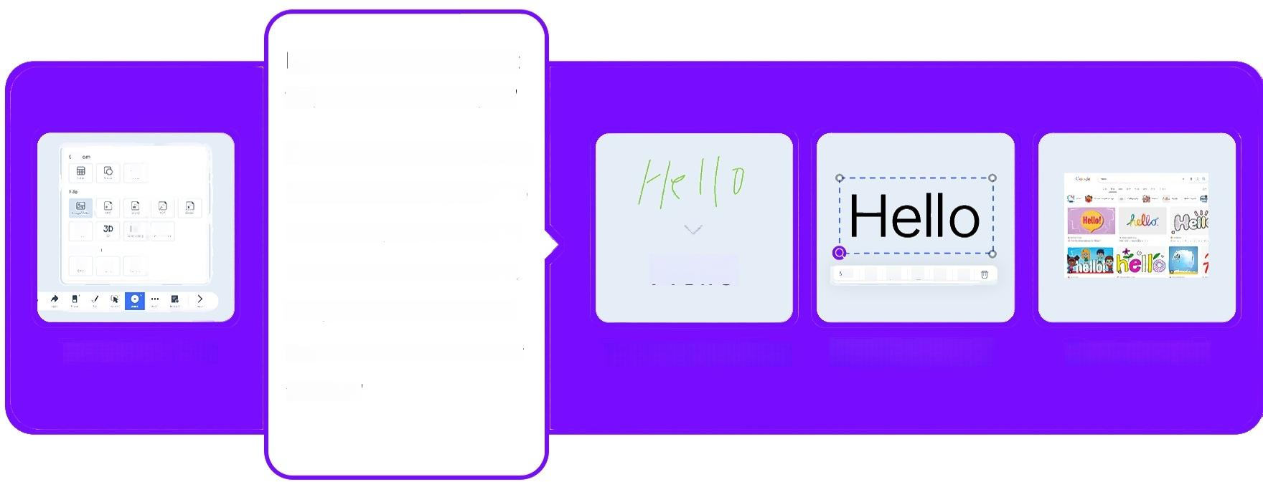
Transform Images into Actionable Insights
From Image to Insight
"Capture.Convert.Conquer."
Dlggre
"With RK3588,capturing an image is just the beginning.Convert it into text and conquer the information it holds.Whether it's documents,
receipts,or notes,RK3588's OCR turns images into insights at your
fingertips."
口
Sgrol source
Q
回
4
恩
Hello
=
6px
Import pictures
Image recognition Object handling Google search

Slide 11

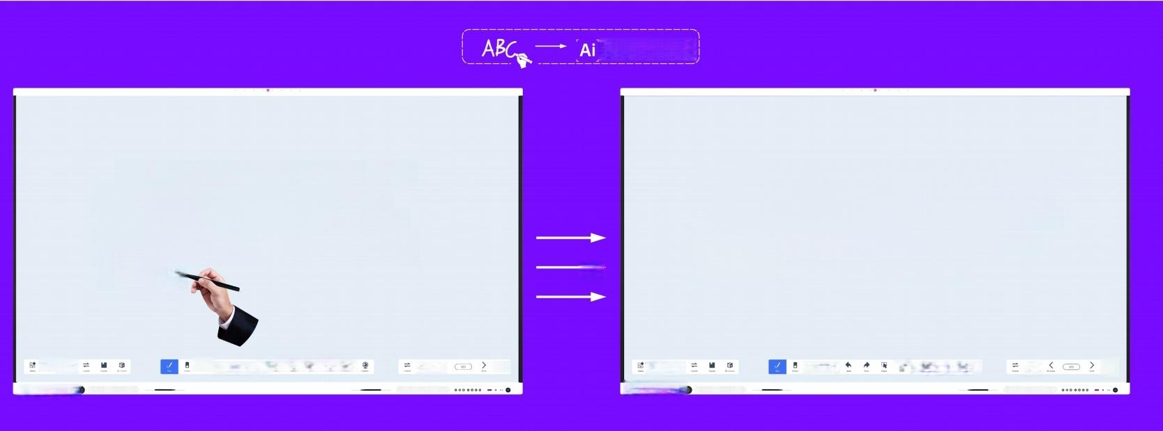
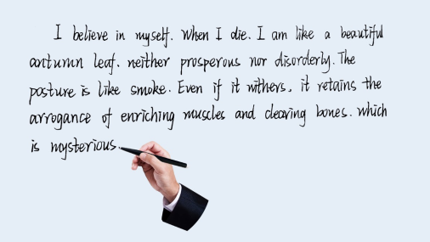

Transform Your Writing with Umind Advanced Al Pen
Al-powered pen tools,integrated into our Umind whiteboard software,offer unparalleled accuracy and intuitive functionality.
—ABC
l believe in myself,When I die.I am like a beautiful antumn leaf.neither prosperous nor disorderly. The posture is like smoke.Even if it withers,it re- tains the arrogance of enriching muscles and
clearing bones.which is mysterious.
* ^{噩}
+
*
▲
±≤
* ^{照}
+
▲
* A 口
里
±

Slide 12
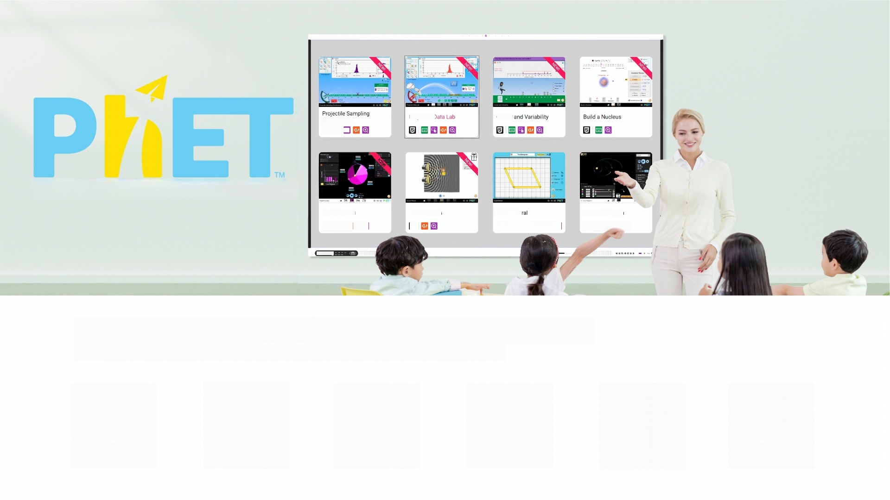


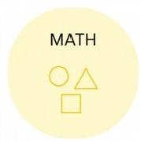



Projectile D Center;
^{is}t四ribut^{ions}
INTERACTIVE SIMULATIONS
Kepler's Laws
回 回民[| 回
Sound Waves
回
Quadrilate
日 四
回
My Solar System
回 回 回
R
lgnite Learning with RK3588-Where Every Subject Shines
PhET Interactive Simulations-Your gateway to a world of science and math,now powered by RK3588.

Slide 13
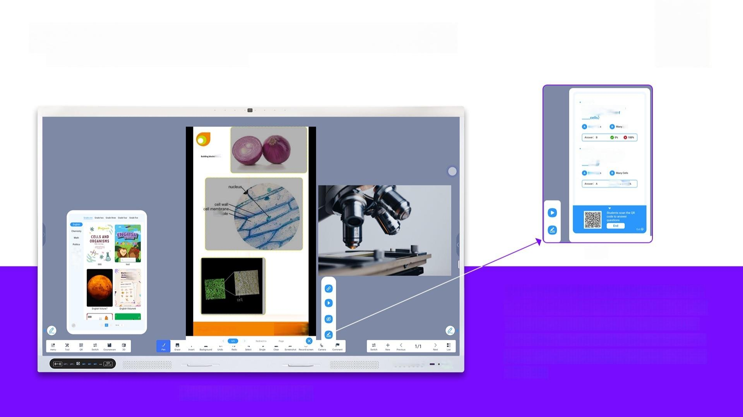

Empowering Education,Amplifying Insights
-Your gateway to a world of science and math
Quiz
From primary to higher education,our platform.covers a
wide range of subjects,igniting curiosity and fostering d- eep understanding.Customize your curriculum,create dynamic content,and contribute to a learning revolution that transforms teaching and empowers learners to ach- ieve more.”
^{Cells} ^{and} ^{Organlsms} _{Riatouch}
Courseware Function-Ucourse

Slide 14
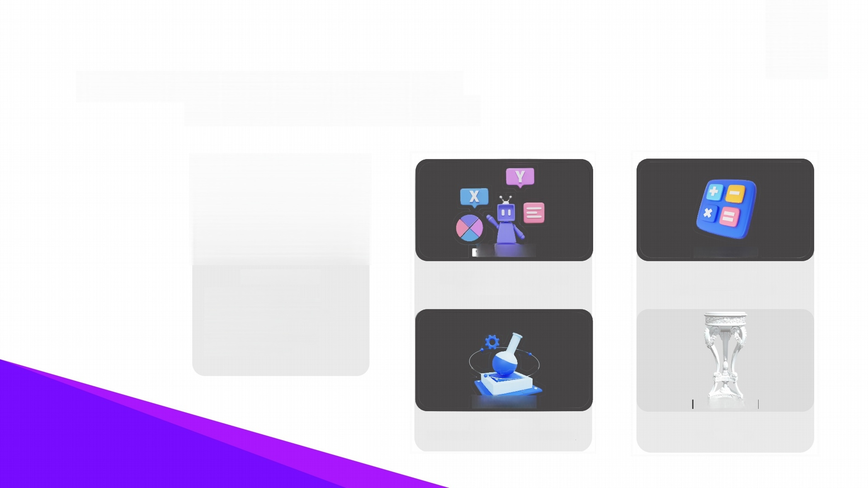
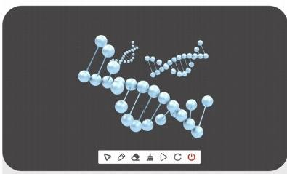
RK3588: The Core of Your 3D Vision
Transform Ideas into Reality
Mathematics
Mathematics and Geometry
Engineering and Technology
Engineering and Robotics
Natural Sciences
Anatomy and Physiology
Geography and Earth Sciences
Chemistry and Molecular Structure
Biology and Ecology
Astronomy and Space Science Physics and Mechanics
Social Sciences
Environmental Science and Sustainability
Arts
Art and Design

Slide 15

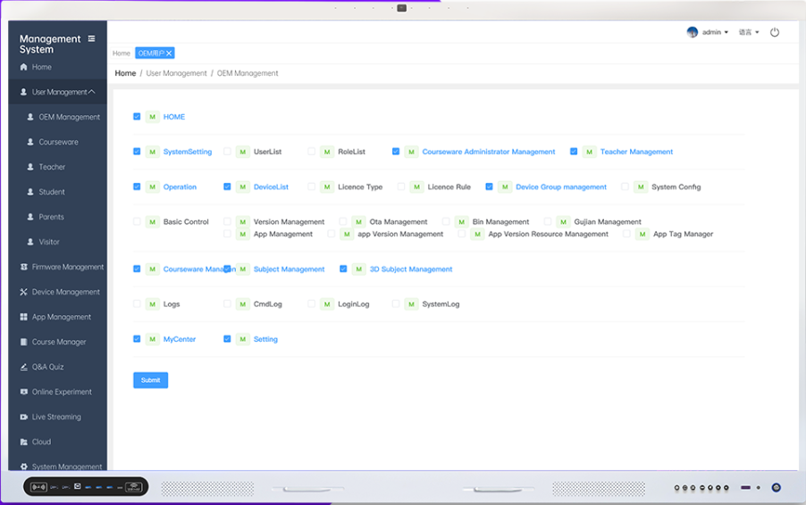


DMS-"Simplfy, Streamline, Secure."
Secure your doсuments, smarten уour management,and enjoy a seamless experience, all in one unified platform!"
Easy Maintenance
& Customization
Secured
Document
Save Cosi
Recovering Fles Liberate Мапромег
Remote Control Save Storage

Slide 16
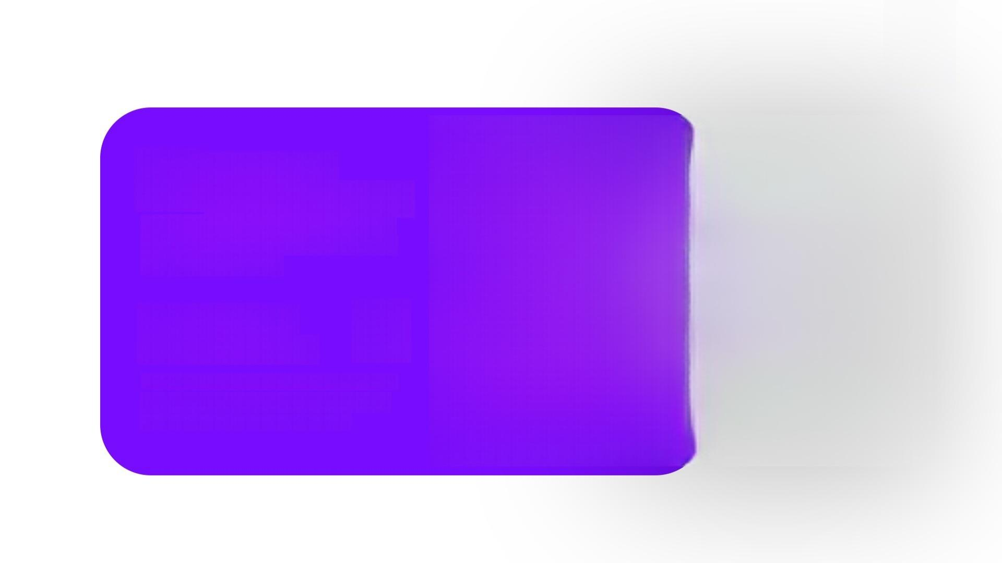
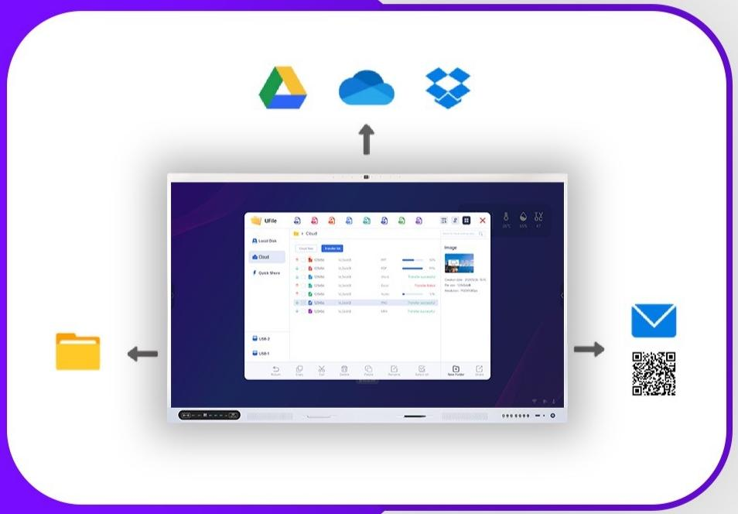


Cloud Sync
Seamless Harmony
"Experience cloud sync lke never before.Our service harmonizes with Google,OneDrive,and more,uniting al your data in perfect sync.'
Secure,Smart,
and Social Cloud
"Secure your data,smarten your access,and socialize your dloud experience.Our service supports Google, OneDrive,and more for a truly social cloud."

Slide 17
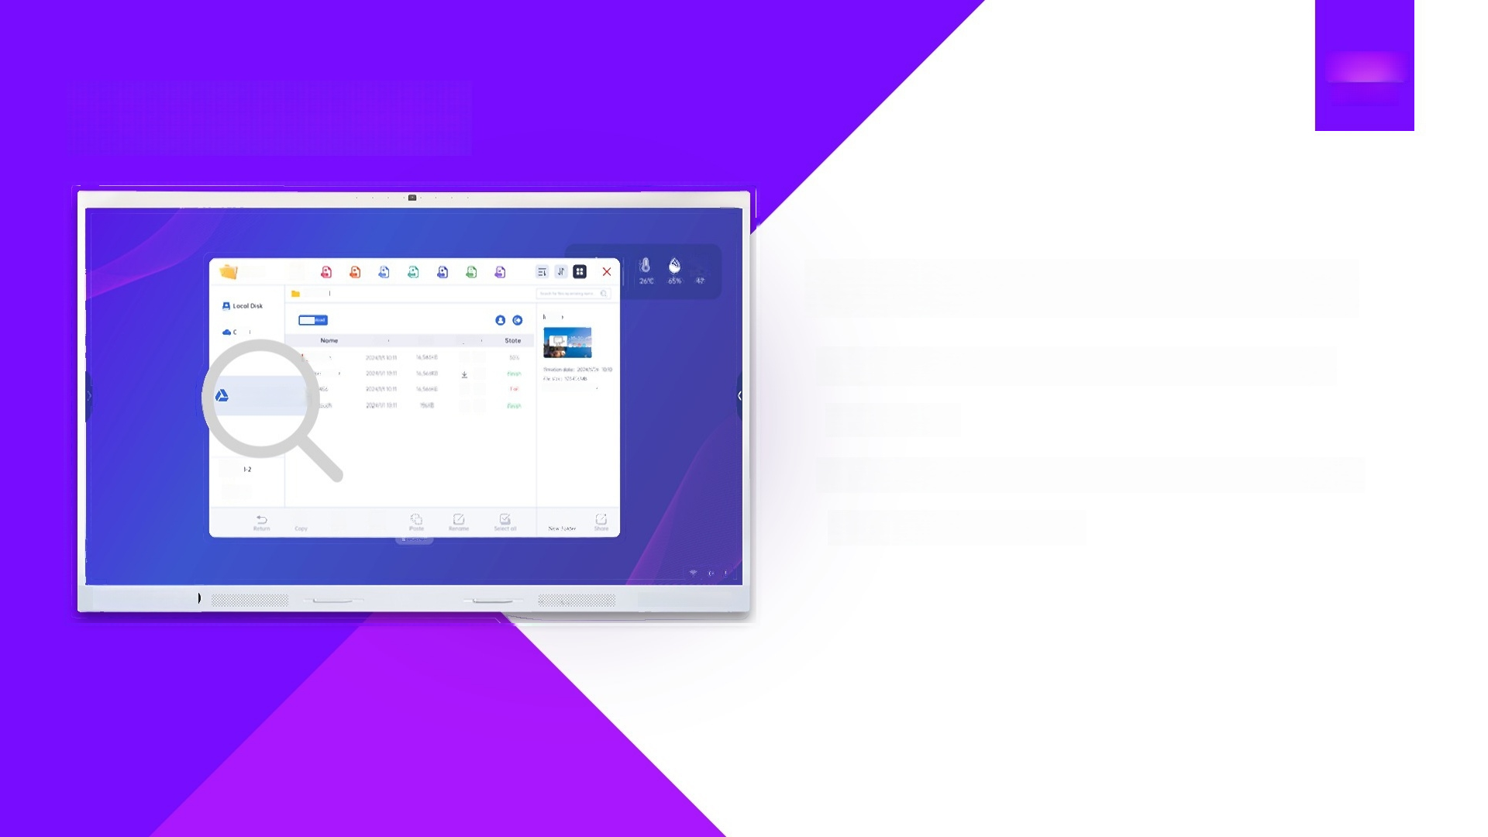
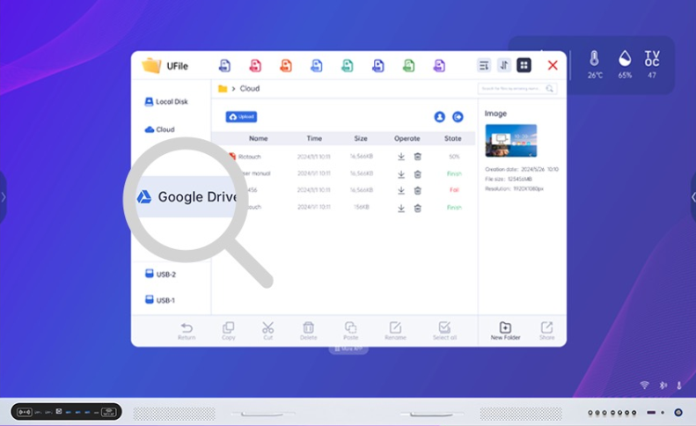
Multiple user login
Beyond the Drive,Into the Cloud
-Step beyond the drive and into the cloud with
our service.
-Multi-user functionality meets Google,OneDrive,
and other cloud giants.
@

Slide 18



The Power of Now In Every Update
Feel the power of now with every OTA update.
Immediate,impactful,and always improving.

Slide 19
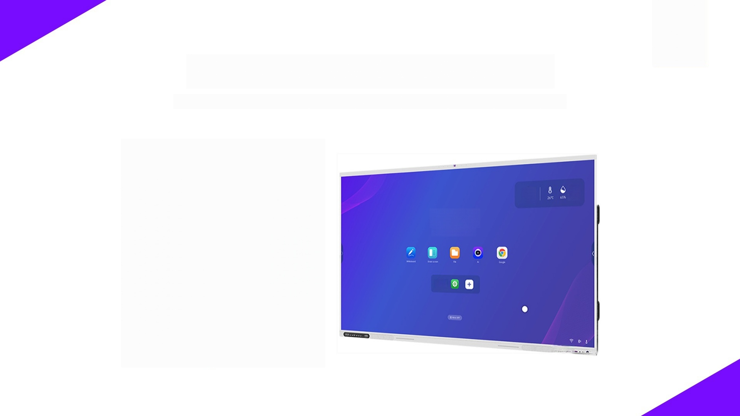

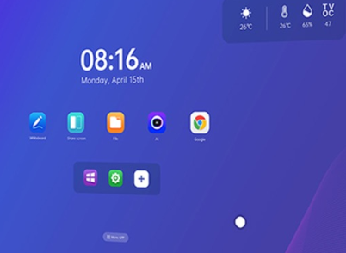
Beyond the Cloud Into the Ecosystem
Take your EDLA experience beyond the cloud and into the rich ecosystem of Google services.

Slide 20

·IR Touch Interactive Flat Panel Display-RK3588
Model |  | LT65RK3588 | LT75RK3588 | LT86RK3588 | LT98RK3588 | LT105RK3588
Diagonal display size |  | 65(inch) | 75(inch) | 86(inch) | 98(inch) | 105(inch)
Bezel color | Aluminum frame(White color) | √ | √ | √ | √ | √
Panel type | UItra HD Direct type LED | √ | √ | √ | √ | √
Active area (mm) |  | 1428.48(H)*803.52(V) | 1649.66*927.93(V) | 1895.04*1065.96(V) | 2187.8(H)×1242.8(V)mm | 2487.4(H)×1070.6(V)mm
Resolution | 3840*2160/60hz | √ | √ | √ | √ | 5120*2160/60hz
Pixel Pitch |  | 0.372mm×0.372mm | 0.429 mm×0.429mm | 0.4935mm×0.4935 mm | 0.5622×0.5622 mm | 0.4785×0,4785
Hardness Glass | Mohs-7 leve | √ | √ | √ | √ | √
Glass Panel | Anti-Glare glass with zero bonding | √ | √ | √ | √ | √
Aspect Ratio | 16:9 | √ | √ | √ | √ | 21:9
Contrast Ratio | 1200:1(type) | √ | √ | √ | √ | 4000:1(type)
Dynamic Contrast Ratio | 4000:1 | √ | √ | √ | 9500:1 | 14000:1
Brightness | General:350cd/m2 Peak 500cd/m2 | √ | √ | √ | 480cd/m2 | 480cd/m2
Color depth | 1.07 billion colors | √ | √ | √ | √ | √
Viewing angle | 178° | √ | √ | √ | √ | √
Lifespan | 50,000 hours | √ | √ | √ | √ | √
Touch Type
Touch Technology | IR touch | √ | √ | √ | √ | √
Multi Touch | Max 40 points(Windows | √ | √ | √ | √ | √
Multi Writing | Max 20 points(Windows) | √ | √ | √ | √ | √
Touch Precision | 1mm(over 90%Area) | √ | √ | √ | √ | √
Auto-Calibration | Yes | √ | √ | √ | √ | √
Anti-light | Yes | √ | √ | √ | √ | √
Minimum object size | 2mm | √ | √ | √ | √ | √
ouch Response Time | First Point<2 ms,Continuation<8 ms | √ | √ | √ | √ | √
Supporting Os | Windows 7/8/10/11;Android;Mac;Linux;Chrome OS | √ | √ | √ | √ | √
Sound
Front Speakers | 15W*2(20W*2 option) | √ | √ | √ | √ | √
Subwoofer | 20W*1 option | √ | √ | √ | √ | 2.0(2.1 option）
Total Power Amplifiers | ⩽60w | √ | √ | √ | √ | √
Microphone (option）
Type | Wide-area microphone | √ | √ | √ | √ | √
Number of Microphones | 8 | √ | √ | √ | √ | √
Auto switch (Windows/Central) | Yes | √ | √ | √ | √ | √
Disconnectable | Yes | √ | √ | √ | √ | √
camera (option)
Number of image | 4800M | √ | √ | √ | √ | √
Maximum resolution and frame rate | 4208*3120(30fps) | √ | √ | √ | √ | √
FOV(field of view) | 120° | √ | √ | √ | √ | √
Front Side Connections
Front Ports | Type-C*1 line;HDMI IN *3 line;USB3.0*2;USB-B*1
Front Keys | Power on/off;Signal source;Setting;ECO;Menu;Volume down;Volume up
NFC | √
Fingerprint | √

Slide 21
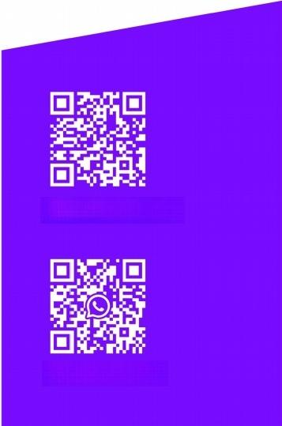
Model | LT65RK3588 |  | LT75RK3588 LT86RK3588 |  | LT98RK3588 | LT105RK3588
Bottom Side Connections
Earphone | 1 | √ | √ | √ | √ | √
MIC IN | 1 | √ | √ | √ | √ | √
SPDIF OUT | 1 | √ | √ | √ | √ | √
RS232 | 1 | √ | √ | √ | √ | √
Touch USB(USB B) | 2 | √ | √ | √ | √ | √
HDMI IN | 1 | √ | √ | √ | √ | √
HDMI OUT | 1 | √ | √ | √ | √ | √
RJ45 | 1 | √ | √ | √ | √ | √
TYPE C OUT | 1 | √ | √ | √ | √ | √
Android USB2.0 | 1 | √ | √ | √ | √ | √
Android USB3.0 | 1 | √ | √ | √ | √ | √
TF CARD | 1 | √ | √ | √ | √ | √
WIFI | WIFI5+WIFI6+AP | √ | √ | √ | √ | √
Nindows OPS Slo | 80-pins OPS slo | √ | √ | √ | √ | √
Bluetooth version | 5.2 | √ | √ | √ | √ | √
Riotouch Centra
Android Version | Android 13.0 | √ | √ | √ | √ | √
Chip | Rockchip RK3588 | √ | √ | √ | √ | √
CPU | uad-core Cortex-A76 and quad-core Cortex-A55,up to 2.4GHz | √ | √ | √ | √ | √
GPU | Mali-G610 MC4 | √ | √ | √ | √ | √
RAM | 8GB 16GB 32GB DDR4 | √ | √ | √ | √ | √
Flash | 128GB 256GB | √ | √ | √ | √ | √
Compliant with | Windows;Mac;Linux;Chrome OS | √ | √ | √ | √ | √
Over-the-Air Updates (OTA) | YES | √ | √ | √ | √ | √
Light Sensor | YES | √ | √ | √ | √ | √
NFC Reader/Writer | YES | √ | √ | √ | √ | √
Temperature,humidity and air quality three-in-one sensor | YES | √ | √ | √ | √ | √
Fingerprint module | YES | √ | √ | √ | √ | √
General Information
Power Supply | ～100-240 V(50/60Hz) | √ | √ | √ | √ | √
Switch On /Off | Yes | √ | √ | √ | √ | √
Standby Energy Consumption | ≤0.5 Watt | √ | √ | √ | √ | √
Power Consumption |  | Maximun<290W Eco<75W | Maximun<320W Eco<75W | Maximun<350W Eco<75W | Maximun<510W Eco<75W | Maximun<460W Eco<75W
Net Weigh | (KG±2) | 45 | 55 | 70 | 110 | 140
Gross Weigh | (KG±2 | 55 | 68 | 85 | 120 | 150
Screen Dimensions | (WxDxH) | 1470.9*97.5*897.5 mm | 1692.1*97.5*1021.9 mm | 1943.4*97.5*1166 mm | 2250*97.5*12305mn | 2505*97.5*1085mm
Dimensions Package | (WxDxH) | 1622*190*1038mm | 1842*190*1163 mm | 2090*190*1307 mm | 2377*220*1486mm | 2550*222*1120mm
VESA Standard | (mm) | 600*400 mm | 600*400 mm | 800*600 mm | 1195*220mm 630*47.5mn | 1195*220mm 630*47.5mm
Certifications | CE:EMC+LVD/RoHS/REACH/FCC/CCC
Warranty | ONE year for the whole product and THREE years for touch parts by default.(can be extended,it's for an option) | √ | √ | √ | √ | √
Environmental conditions
Operating Temperature | 0℃- 40℃/32-100℉ | √ | √ | √ | √ | √
Storage Temperature | -20℃- 60℃/-4-140℉ | √ | √ | √ | √ | √
Storage Humidity | 10%-90% | √ | √ | √ | √ | √
Usage Humidity | 10%-90% | √ | √ | √ | √ | √
Accessories
Accessories | WIFl antenna*5pcs;No ink pen*2pcs,Remote control *1pcs,1.5m power cord *1pcs,1.5m HDMI cable *1pcs,1.5m USB touch cable*1pcs;wall mount ki
www.riotouch.com
+8613631706431

